Slide 1
YEAR 5 AT HOMEFIELDS
Mr Harrison
Miss Clover

Slide 2
Equipment needed
2 HB pencils
Rollerball/ handwriting pens (blue and black ink) - not ballpoint whiteboard pens (we run out of these regularly) rubber
30cm clear ruler pencil sharpener glue stick scissors protractor highlighters
Colouring pencils and felt tips

Slide 3
School Uniform
Please follow this link to our school website to find information about school uniform:
https://primarysite-prod-sorted.s3.amazonaws.com/homefields-primary-school/UploadedDocument/71503b8451ea496d8fa4e2f2d7a82f5e/homefields-primary-school-checklist.docx.pdf

Slide 4
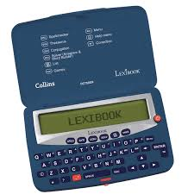
Desirable equipment
Electronic spell-checker with thesaurus
This will really support their writing.

Slide 5
P.E. Days Autumn Term
P.E. (Please come to school in P.E. clothes)
Mr Harrison – Tuesday and Friday (rugby)
Miss Clover – Tuesday and Friday (rugby)
Please refer to the dress code information.
OPAL Play
Wellies needed for children to use the field when the weather becomes wet.

Slide 6
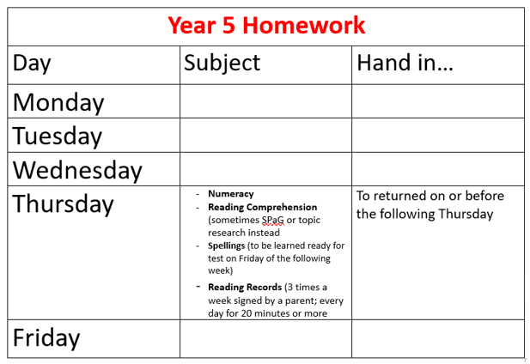

Slide 7





Reading
Notes:
Develop stamina to read longer novels
Be able to P.EE
Authorial intent

Slide 8
Children need to develop the skills to read with speed, stamina and understanding. It is important that children continue to read daily from a range of texts (fiction, non-fiction and poetry).
Key Reading Skills:
Vocabulary
Inference
Predict
Explain
Retrieve
Summarise

Slide 9


Slide 10
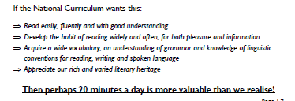

Slide 11
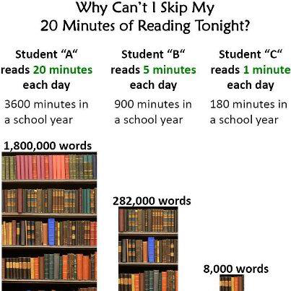
Get hooked on books!KGE

Slide 12


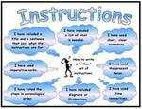
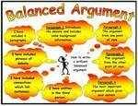
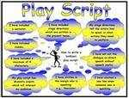
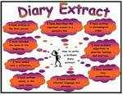


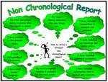

Writing
Throughout the year, year 5 children will practise writing from a range of genres (see above). These will often be based on a class novel. In the first half of the autumn term, year 5 will be reading ‘Kensuke’s Kingdom’ by Michael Morpurgo’. It would be beneficial for all children to have their own copy of this novel to use during lessons. Writing is teacher assessed throughout the year.

Slide 13
Children will continue to develop the skills to be responsible for editing and improving their work themselves! This is what the black pen is for. Year 5 children are responsible for completing and returning homework.

Slide 14
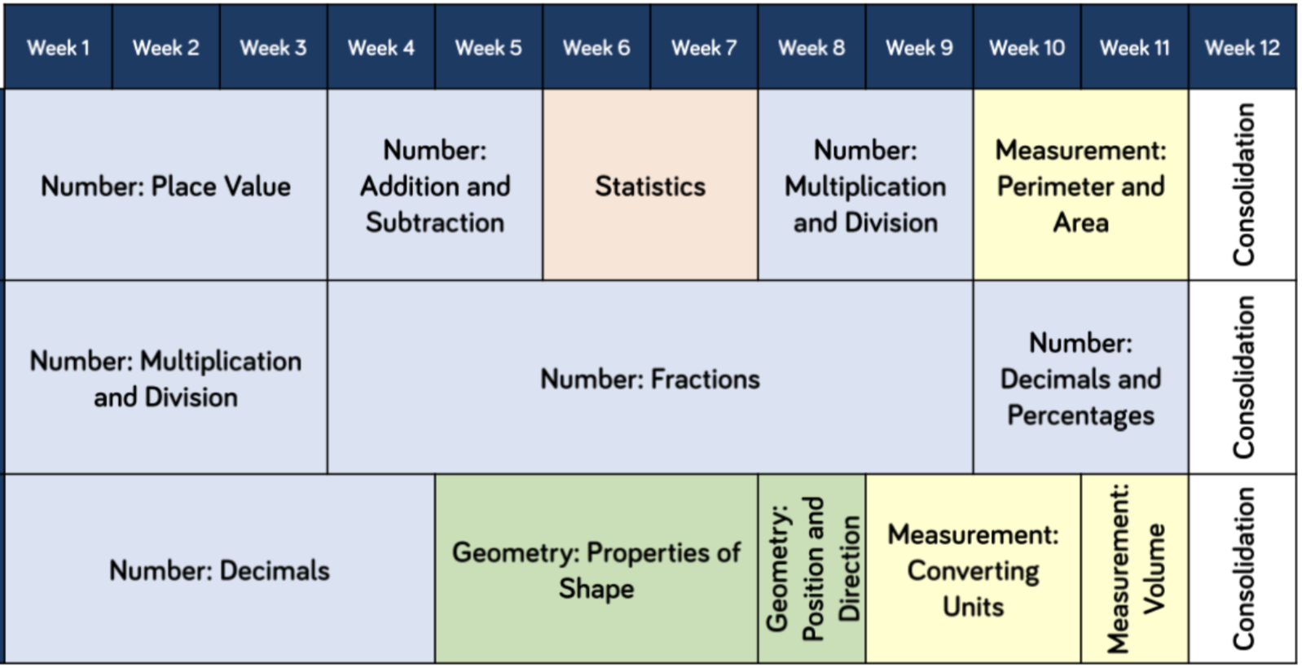
Calculation Workshop
On Tuesday 22nd September at 4.00 pm there will be a session to outline and explain the calculation methods that children will learn and develop in year 5 and 6. You are welcome to join us.

Slide 15
Communication
Classdojo – this will now be used for class announcements and photos, etc. Not for communication with parents.
School Website – class pages for information about topics.
E-mail is the main form of communication with class. teachers and the office – please check details are correct. Please inform the office directly of absence.
Mr Harrison: Year5-6@homefieldsprimary.org
Miss Clover: Year5@homefieldsprimary.org
Smart Watches with a photographic function – please avoid children wearing these to school.
Walking home permission

Slide 16







Children and Social Media
13
13
16
13
13
13 to create an account but 16 or 18 for some features
18 or 13 with parental permission

Slide 17
Trips!
Carsington –Rivers Topic – June 2027

