Slide 1

Percentages
To be able to find percentages of amounts

Slide 2
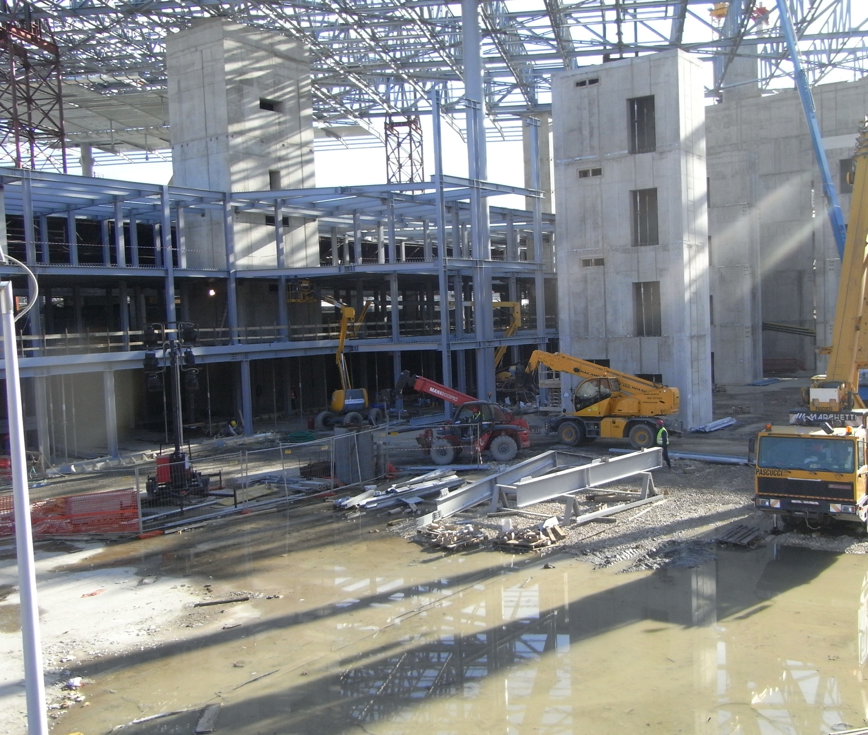
Tool kit:
We can easily find-
1%
10%
20%
25%
50%
Find 60% of 900g
60%
540g
10%
90g
50%
450g
60% of 900g=540g

Slide 3
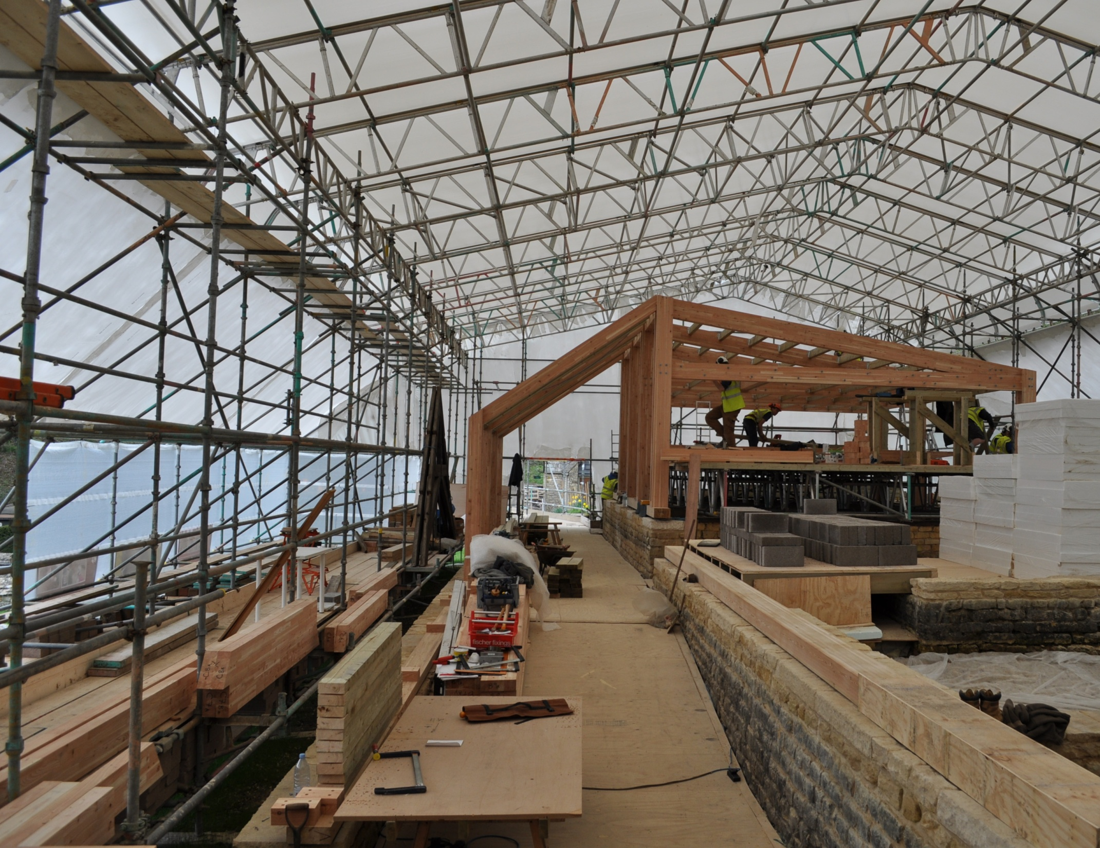
Tool kit:
We can easily find-
1%
10%
20%
25%
50%
Find 21% of 400
21%
1%
4
84
20%
80
21% of 400=84

Slide 4

Tool kit:
We can easily find-
1%
10%
20%
25%
50%
Find 46% of 500
1%
46%
5
230
20%
100
25%
125
46% of 500=230

Slide 5

Tool kit:
We can easily find-
1%
10%
20%
25%
50%
Find 72% of 500
5
1%
360
72%
x2
1%
5
20%
100
50%
250
72% of 500=360

Slide 6

Questions
Find:
35% of £400
60% of 360kg
75% of 500cm
11% of £820
26% of 700p
51% of 600m
76% of 920
30% of 85mm²
62% of 440
90% of 960ml
Answers:
a) £140
b) 216kg
c) 375cm
d) £90.20
e) 182p
f) 306m
g) 899.2
h) 25.5mm²
i) 272.8
j) 864ml

