Slide 1


Fractions, Decimals and Percentages
for Year 5 and 6

Slide 2
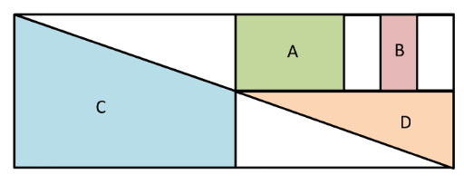
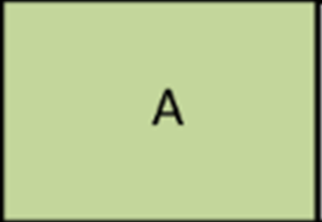
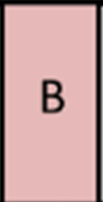
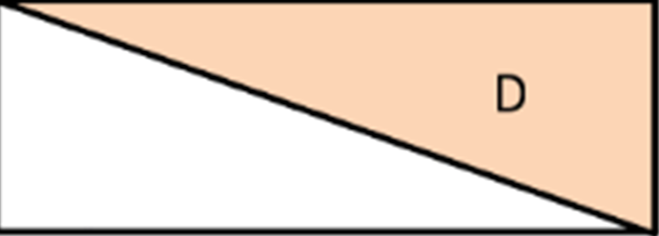
Understanding Fractions

Slide 3


Simplifying Fractions
=
Find the highest common factor.
Simplest for or lowest terms.
=

Slide 4
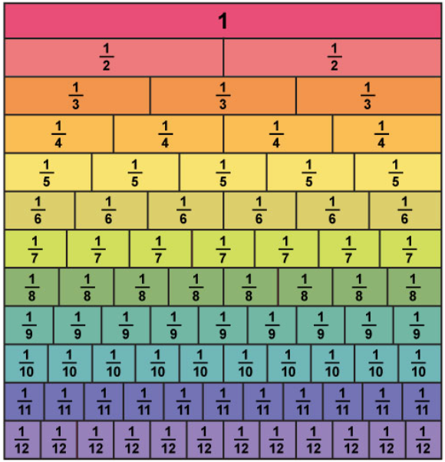

Slide 5

Comparing Fractions
<, > or = ?
Which is larger?
Find a lowest common multiple.

Slide 6
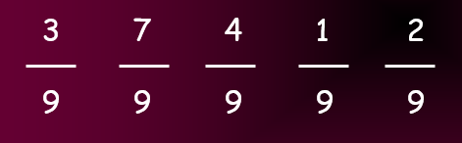
Ordering Fractions

Slide 7
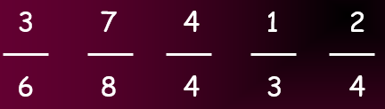
Ordering Fractions
Find a lowest common multiple.

Slide 8
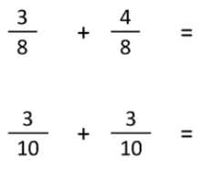
Adding Fractions - Same Denominator

Slide 9

Adding Fractions - Different Denominator
Find a lowest common multiple.

Slide 10

Subtracting Fractions - Same Denominator

Slide 11

Subtracting Fractions - Different Denominator
Find a lowest common multiple.

Slide 12




Mixed numbers to Improper Fractions - vice versa

Slide 13
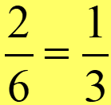
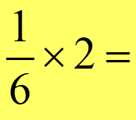
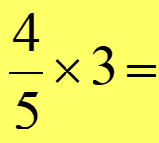
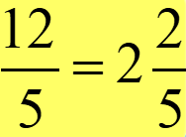
Multiplying Fractions by Integers
Multiply the numerator by the integer.
Will the answer need simplifying?
Improper fraction? Convert to a mixed number.

Slide 14
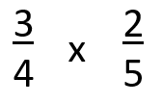

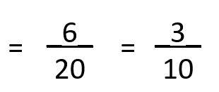
Multiplying Fractions by Fractions
Multiply the numerators and and the denominators.
Then simplify if possible.

Slide 15


Dividing Whole numbers by Fractions
Multiply the denominator by the integer but leave the numerator alone.

Slide 16

Fractions of Amounts
Unit fraction first.
Three-quarters of 164
Then non-unit fraction.
Apply to word problems:

Slide 17
Fractions to Decimal to Percentages
Fractions to Decimals: Divide the numerator by the denominator. For example, 1/4 = 0.25
Decimals to Fractions: Write the decimal places as the numerator, then place it over a denominator of 10, 100 or 1000. For example, 0.75 = 75/100, then simplify.
Percentages to Fractions: Divide the percentage by 100 and simplify. For example, 25% = 25/100, then simplify.
Fractions to Percentages: Multiply the fraction by 100. For example, 1/4 × 100 = 25%
Decimals to Percentages: Multiply the decimal by 100. For example, 0.25 ×100 = 25%
1 ​F

Slide 18
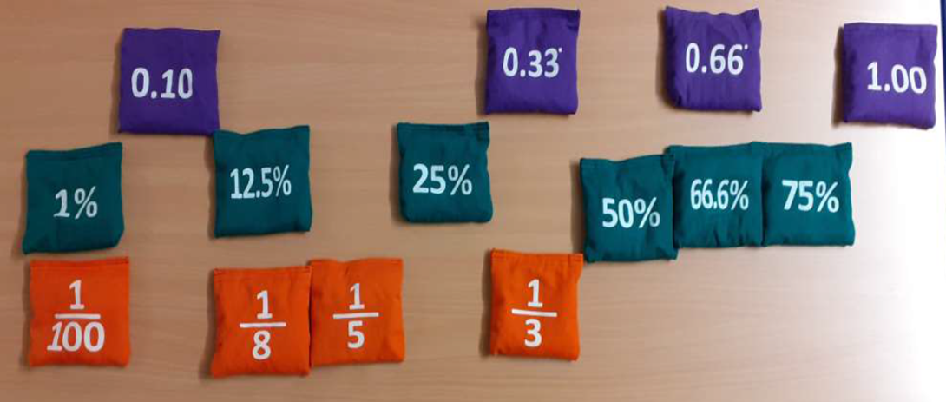
Fractions to Decimal to Percentages

Slide 19
Percentages of Amounts
See 'Percentages of amounts building blocks.ppt'

