Slide 1





Getting all children to
read well, quickly.
Be Kind, Be Courageous, Be Respectful
Phonics Teaching & Early Reading
Phonics Screening Information

Slide 2


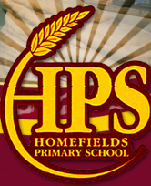

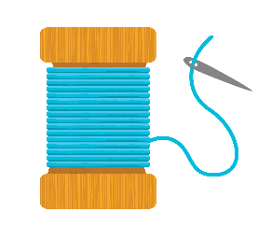
Contents
What is Phonics?
What is Essential Letters and Sounds?
How we teach phonics & Phonic Progression
Getting children ready to read
Supporting your child with reading at home
Pronouncing pure sounds
Using the letter formations and spelling sequence to support writing at home
Preparing for Phonics Screening (Year 1 & Year 2)
© Oxford University Press 2021
Notes:
Overview of Essential Letter and Sounds and how it works
Resources – what they are and how they are used
Assessment and Intervention – what does this look like and how is it implemented
Next Steps – what happens next!
We will check the questions in the chat box at the end of the session so there will be plenty of time to answer and queries then

Slide 3
What is Phonics?
Phonics was introduced in 2007 and focusses on teaching beginners to read and pronounce words by learning to associate letters or letter groups with the sounds they represent.
There are 44 main sounds in the English Language. Each sound is represented by a grapheme (the written representation of a sound).
© Oxford University Press 2021
Notes:
Begin by explaining what Phonics is. Explain that learning to read the English language is complex and that this information session will give parents & carers the understanding of what Phonics is, the terminology used in Phonics and how ELS gives children the skills and knowledge to read well, quickly.

Slide 4
Phonics Terminology
Phoneme: the smallest single identifiable sound in a word.
For example, in the word 'cat' there are three phonemes c/a/t.
Grapheme: the written representation of a sound.
Digraph: two letters making one sound. For example, /sh/ in the word 'shop'.
Trigraph: three letters making one sound. For example, /igh/ in the word 'night'.
Split digraph: two vowel letters split but are split by one or more consonants. For example, /a-e/ in the word 'cake'.
© Oxford University Press 2021
Notes:
Use flashcards to put this into context. Show parents examples of graphemes, digraphs, trigraphs and split digraphs. Where possible, make the link between same sound, different spelling.
Example:
<a>
acorn
<ai>
rain
<ay>
play
<a-e>
name
<eigh>
eight
<ey>
they
<ea>
great
<aigh>
straight

Slide 5
Phonics Terminology
HRS: Harder to Read and Spell Words used to be known as ‘Tricky words’. These words cannot be spelt by applying phonic knowledge e.g. was, said.
Blending – combining broken up sounds to make a word. For example, you hear p-i-h and you merge the sounds together to make the single word ‘pig’. This is a key skill of early reading.
Segmenting – Breaking a word into its constituent sounds in order to spell them e.g. s-n-ai-l
© Oxford University Press 2021
Notes:
Use flashcards to put this into context. Show parents examples of graphemes, digraphs, trigraphs and split digraphs. Where possible, make the link between same sound, different spelling.
Example:
<a>
acorn
<ai>
rain
<ay>
play
<a-e>
name
<eigh>
eight
<ey>
they
<ea>
great
<aigh>
straight

Slide 6
What is ELS?
Essential Letters and Sounds (ELS) is our chosen phonics programme
Children will experience the joy of books and language whilst rapidly acquiring the skills they need to become fluent independent readers and writers.
© Oxford University Press 2021
Notes:
We use phonemes and graphemes to teach children the code of our language.
English is one of the most challenging languages to learn as there are so many ways to spell the sounds of our language.
We teach children to decode words – by identifying each of the written sounds within the word before blending them together to read the word. This is a challenging process for children to learn and takes time to master. When they are able to decode and blend to....

Slide 7
How do we teach phonics?
We use a simple, consistent approach to teaching phonics.
We have mnemonics and rhymes to support learning and recall
We teach phonics every single day from the first days of Reception
© Oxford University Press 2021
Notes:
Phonics teaches the link between the spoken sounds of our language and the written version of that sound – the code of our language.
As systematic synthetic phonics programme breaks this down into tiny steps for children to piece together which allows them to decode to read and then spell using the sound to spelling correspondences they have learnt.
We use a simple, consistent approach to teaching phonics.
Your child will experience the same classroom routines within each lesson which reduces cognitive load and maximises the chances of success.
All children are supported within the lesson to use their new phonic knowledge independently.
In every single ELS lesson, your child will make the direct application to reading.

Slide 8
How do we teach phonics?
Lots of opportunities for oral blending- /c/ /oa/ /t/
We teach the ‘code’ for reading, alongside teaching vocabulary.
We model phonic skills regularly.
© Oxford University Press 2021

Slide 9

ELS Progression
We begin our Phonics in FS1 where the children experience Phase 1.
In Reception your children will learn all the single letter sounds and begin to learn diagraphs and trigraphs.
© Oxford University Press 2021
Notes:
In Reception your children will learn all the single letter sounds and begin to learn diagraphs and trigraphs.

Slide 10

ELS Progression
CVCC
In Year 1 the children recap previously taught GPCs and learn new alternative spelling patterns.
© Oxford University Press 2021

Slide 11
Phase 1
Taught in Nursery
This phase is divided into seven strands:
Aspect 1: Environmental Sounds Children are exposed to a variety of sounds in the environment, being encouraged to copy them.
Aspect 2: Instrumental Sounds Children are encouraged to listen to and make sounds using different instruments.
Aspect 3: Body Percussion Children use their body to accompany songs and rhymes, for example by clapping and tapping.
Aspect 4: Rhythm and Rhyme Children are exposed to a range of books and rhymes. Children are encouraged to join in with repeated refrains and rhymes.
Aspect 5: Alliteration Children are encouraged to listen to initial sounds within words. They are asked to think of other words beginning with the same sound.
Aspect 6: Voice Sounds Children are asked to create different mouth movements and say a range of sounds.
Aspect 7: Oral Blending and Segmenting
This stage is vital before children are exposed to grapheme to phoneme correspondence (learning which letter represents each sound). It is all done orally and is to encourage children to hear the separate sounds within words.
© Oxford University Press 2021
Notes:
Overview of Essential Letter and Sounds and how it works
Resources – what they are and how they are used
Assessment and Intervention – what does this look like and how is it implemented
Next Steps – what happens next!
We will check the questions in the chat box at the end of the session so there will be plenty of time to answer and queries then

Slide 12
Ways You Can Support Your Child at Home
Share a range of rhymes.
Practise oral blending in and around the home. You can do this by talking in the following way:
c-a-t, cat
Can you put on your s-o-ck?
Initially, the children will just listen and then with time, they will be able to join in, hearing the words the sounds create.
© Oxford University Press 2021
Notes:
Overview of Essential Letter and Sounds and how it works
Resources – what they are and how they are used
Assessment and Intervention – what does this look like and how is it implemented
Next Steps – what happens next!
We will check the questions in the chat box at the end of the session so there will be plenty of time to answer and queries then

Slide 13
Phase 2
Taught in FS2
12 New Harder to read and spell words
23 New GPCS
This phase builds upon the oral blending and segmenting of the previous phase. Children must continue to practise what they have learnt. They will also then be taught the grapheme-phoneme representations (letters) in the table below.
Additionally, they will be taught that phonemes (sounds) can be represented by more than one letter. E.g. fin, huff
Set 1 | Set 2 | Set 3 | Set 4 | Set 5
s a t p | i n m d | g o c k | ck e u r | ss h b f, ff l, ll
Harder to read and spell words
go
I
into
is
no
of
pull
put
the
to
© Oxford University Press 2021
Notes:
Overview of Essential Letter and Sounds and how it works
Resources – what they are and how they are used
Assessment and Intervention – what does this look like and how is it implemented
Next Steps – what happens next!
We will check the questions in the chat box at the end of the session so there will be plenty of time to answer and queries then

Slide 14
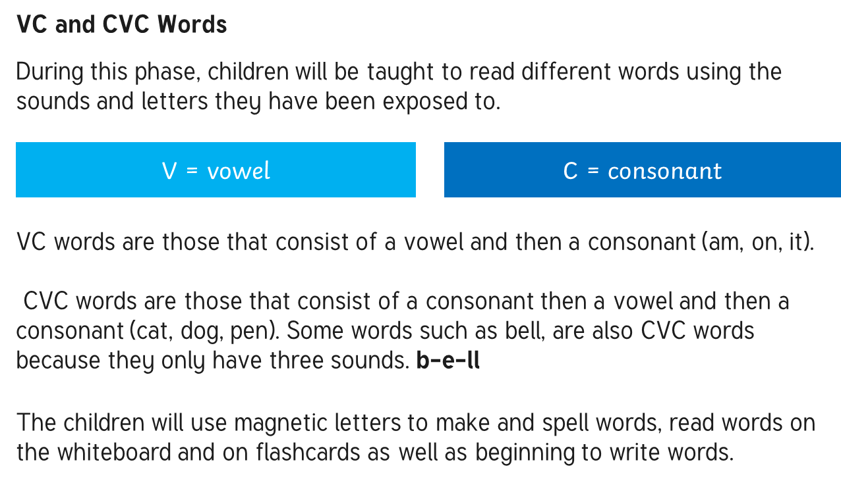
© Oxford University Press 2021
Notes:
Overview of Essential Letter and Sounds and how it works
Resources – what they are and how they are used
Assessment and Intervention – what does this look like and how is it implemented
Next Steps – what happens next!
We will check the questions in the chat box at the end of the session so there will be plenty of time to answer and queries then

Slide 15
Pronouncing pure sounds
We must use pure sounds when we are pronouncing the sounds and supporting children in reading words.
c a t not cuh a tuh
If we mispronounce these sounds we will make reading harder for our children.
There are videos for this on our school website where you can hear the correct pronunciation of the sounds.
Phonics | Homefields Primary School (secure-primarysite.net)
© Oxford University Press 2021
Notes:
If we use the ‘uh’ sound after the pure sound we are teaching the schwa.
For example instead of /c/ /a/ /t/ we teach /cuh/ /a/ /tuh/ - cuhatuh – not a word! IT makes blending harder if you teach or use a schwa after the initial sound.

Slide 16
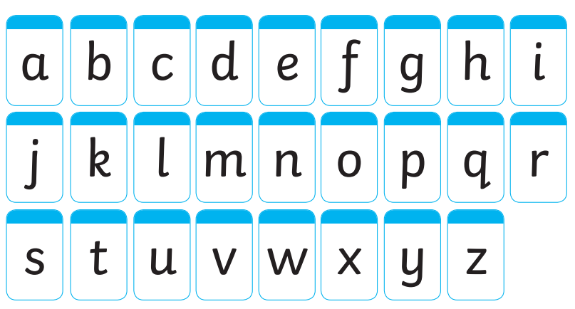

Slide 17
Ways You Can Support Your Child at Home
Using the sounds the children have been exposed to, the
following games and activities can be done.
Practise new sounds using the parent handout sheets which have the picture and mnemonic learnt. Remember to use pure sounds.
Magnetic letters - Using magnetic letters on the fridge or any type of magnetic surface, children can practise making words.
Make words using letter cards or bath letters. Ask the children to blend the sounds together to make the words.
Ask children to spell out CV and CVC words both orally and on paper.
© Oxford University Press 2021
Notes:
Overview of Essential Letter and Sounds and how it works
Resources – what they are and how they are used
Assessment and Intervention – what does this look like and how is it implemented
Next Steps – what happens next!
We will check the questions in the chat box at the end of the session so there will be plenty of time to answer and queries then

Slide 18
29 New GPCS
Phase 3
Taught in Reception
32 New Harder to read and spell words
Sounds and Digraphs
The following sounds are taught:
Set 6 | Set 7
j v w x | y z, zz qu, ch
Following sets of digraphs and trigraphs
sh th ng nk | ai ee igh oa
oo ar ur oo or | ow oi ear air (Cow)
ure er ow (window)
© Oxford University Press 2021
Notes:
Overview of Essential Letter and Sounds and how it works
Resources – what they are and how they are used
Assessment and Intervention – what does this look like and how is it implemented
Next Steps – what happens next!
We will check the questions in the chat box at the end of the session so there will be plenty of time to answer and queries then

Slide 19
CVC Words Containing Digraphs and Trigraphs
Below are some examples of the words your child will be reading in this phase:
ship
cook
fork
high
beard
chair
Frequent practise allows your child to become more fluent.
Useful Tip
It is important children quickly learn to recognise digraphs and trigraphs as one sound, rather than as separate letters.
E.g. rain should be read as r-ai-n not r-a-i-n
Harder to Read and Spell Words
During this phase, the children will also be exposed to HRS; words that cannot be sounded out.
all
are
as
ball
be
buses
children
come
do
have
he
her
his
like
little
love
me
one
out
push
said
she
so
some
tall
there
they
was
we
were
when
what
© Oxford University Press 2021
Notes:
Overview of Essential Letter and Sounds and how it works
Resources – what they are and how they are used
Assessment and Intervention – what does this look like and how is it implemented
Next Steps – what happens next!
We will check the questions in the chat box at the end of the session so there will be plenty of time to answer and queries then

Slide 20
Ways You Can Support Your Child at Home
Using the sounds the children have been exposed to, the
following games and activities can be done.
Use the parent handouts to practise the pronunciation and mnemonic to help the children remember these on sight. Try to increase the speed at which children are shown the sounds.
Ask children to write graphemes already taught.
Play ‘I Spy’ using letter names as well as sounds.
Continue to use magnetic letters to make and spell words.
Ask children to spell out CV and CVC words both orally and on paper.
Write HRSW on flashcards and stick them around the house. How many can they read in a set amount of time?
© Oxford University Press 2021
Notes:
Overview of Essential Letter and Sounds and how it works
Resources – what they are and how they are used
Assessment and Intervention – what does this look like and how is it implemented
Next Steps – what happens next!
We will check the questions in the chat box at the end of the session so there will be plenty of time to answer and queries then

Slide 21
No New GPCS
No New Harder to read and spell words
Phase 4
Taught in Reception
CVCC and CCVC Words
The children are taught to read words with different word structures e.g.
CVCC, CCVC, CCVCC, CCCVC, CCCVCC
tent
spoons
toast
Splash
plum
Scrimp
The children will learn to read words with suffixes
* Words with –ed endings - creaked
* Words with –ed sounding like t – e.g. jumped
* Words with –ed sounding like d – laughed
* words ending with –er and –est – smaller, smallest
© Oxford University Press 2021
Notes:
Overview of Essential Letter and Sounds and how it works
Resources – what they are and how they are used
Assessment and Intervention – what does this look like and how is it implemented
Next Steps – what happens next!
We will check the questions in the chat box at the end of the session so there will be plenty of time to answer and queries then

Slide 22
Ways You Can Support Your Child at Home
Using the sounds the children have been exposed to, the
following games and activities can be done.
Continue to use flashcards with the sounds already taught.
Practise sounding out a range of CVCC and CCVC words.
Ask your child to make a word using magnetic letters or to write it down.
© Oxford University Press 2021
Notes:
Overview of Essential Letter and Sounds and how it works
Resources – what they are and how they are used
Assessment and Intervention – what does this look like and how is it implemented
Next Steps – what happens next!
We will check the questions in the chat box at the end of the session so there will be plenty of time to answer and queries then

Slide 23
Phase 5
Taught in Reception & then in Year 1
Year 1
Autumn
2 New GPCS
9 New HRS
FS2 –
20 New GPCs
16 New HRS words
The purpose of this phase is to broaden a child’s knowledge of graphemes and phonemes for use in reading and spelling. When spelling words, children will now need to choose the appropriate graphemes to represent phonemes.
Some of the new Graphemes for Reading:
ay
ou
ie
ea
oy
ir
ue
aw
wh
ph
ew
oe
au
ey
a-e
e-e
i-e
o-e
u-e
c
Year 1
Spring
49 New GPCS
4 New HRS
y
al
© Oxford University Press 2021
Notes:
Overview of Essential Letter and Sounds and how it works
Resources – what they are and how they are used
Assessment and Intervention – what does this look like and how is it implemented
Next Steps – what happens next!
We will check the questions in the chat box at the end of the session so there will be plenty of time to answer and queries then

Slide 24
Useful Tip
Split digraphs are introduced in Phase 5.
a-e e-e i-e o-e u-e
Children will learn that the ‘e’ on the end causes the initial vowel to make the longer vowel sound rather than the shorter one.
E.g. ay ee igh ow oo
Harder to Read and Spell Words
During this phase, the children will also be exposed to HRS words that cannot be sounded out.
again
any
ask
asked
because
could
friend
here
house
many
mouse
Mr
Mrs
oh
once
people
please
should
sugar
their
two
very
want
water
where
who
whole
would
your
© Oxford University Press 2021
Notes:
Overview of Essential Letter and Sounds and how it works
Resources – what they are and how they are used
Assessment and Intervention – what does this look like and how is it implemented
Next Steps – what happens next!
We will check the questions in the chat box at the end of the session so there will be plenty of time to answer and queries then

Slide 25
Ways You Can Support Your Child at Home
Using the sounds the children have been exposed to, the
following games and activities can be done.
Ask your child to make or spell words. Support them whilst they figure out how the sound needs to be represented.
Focus on split digraphs using flashcards, try to increase the speed you
show children.
Encourage children to write as many sounds/words as possible in a set amount of time.
Expose children to a wider range of stories which include longer texts.
© Oxford University Press 2021
Notes:
Overview of Essential Letter and Sounds and how it works
Resources – what they are and how they are used
Assessment and Intervention – what does this look like and how is it implemented
Next Steps – what happens next!
We will check the questions in the chat box at the end of the session so there will be plenty of time to answer and queries then

Slide 26
Phase 6
Taught in Year 2
In Phase 6 Phonics the main aim for children is to develop their fluency as a reader and increase their accuracy when spelling. They will have already learnt the most often used grapheme-phoneme correspondences (GPCs) in the English language. Children will be able to sight-read a large number of words. When coming across an unfamiliar word, they have a range of strategies to decode them including their sounding and blending skills.
In terms of reading, children will continue to develop three main skills throughout Phase 6:
■ reading the words automatically if they are very familiar;
■ decoding them quickly and silently because their sounding and blending routine is
now well established;
■ decoding them aloud.
.
© Oxford University Press 2021
Notes:
Overview of Essential Letter and Sounds and how it works
Resources – what they are and how they are used
Assessment and Intervention – what does this look like and how is it implemented
Next Steps – what happens next!
We will check the questions in the chat box at the end of the session so there will be plenty of time to answer and queries then

Slide 27
Phase 6
Taught in Year 2
The goal is for children to also become confident spellers, although spelling typically lags behind reading as it is usually more difficult for children to grasp. During this phase, children will start to spell more complex words. They will continue to work on spellings and skills which are more difficult, for example:
using suffixes to indicate tenses
the rules for adding -ing, -ed, -er, -est, -ful, -ly and -y
plural spelling
using prefixes to change words
© Oxford University Press 2021
Notes:
Overview of Essential Letter and Sounds and how it works
Resources – what they are and how they are used
Assessment and Intervention – what does this look like and how is it implemented
Next Steps – what happens next!
We will check the questions in the chat box at the end of the session so there will be plenty of time to answer and queries then

Slide 28

How do we teach phonics?
In ELS we do not ask children questions before we have taught them.
For example, when teaching a new sound, rather than asking children if they know any words with the sound in - we give the children 3 words that contain that sound. You can try this with your children at home.
© Oxford University Press 2021
Notes:
In ELS we do not ask children questions before we have taught them.
For example, when teaching a new sound, rather than asking children if they know any words with the sound in - we give the children 3 words that contain that sound. You can try this with your children at home.

Slide 29


How do we teach phonics?
The new teaching is always highlighted so that it is easy for all children to see where the new GPC they have been taught is located. First we say the new sound, then we find it in the word. Finally, we decode and blend. Children have as much or as little support as needed. We want every child to feel confident and successful at each step.
© Oxford University Press 2021
Notes:
The new teaching is always highlighted so that it is easy for all children to see where the new GPC they have been taught is located. First we say the new sound, then we find it in the word. Finally, we decode and blend. Children have as much or as little support as needed. We want every child to feel confident and successful at each step.

Slide 30

How do we teach phonics?
In the beginning of Reception, we learn to read words and then captions, phrases and sentences. As children learn more of the code of our language we are able to build more complex sentences for them to read.
Here we have a sentence from Year One. We build the code for the children and as this knowledge grows we are able to read more complex sentences.
© Oxford University Press 2021
Notes:
In the beginning of Reception, we learn to read words and then captions, phrases and sentences. As children learn more of the code of our language we are able to build more complex sentences for them to read.
Here we have a sentence from Year One. We build the code for the children and as this knowledge grows we are able to read more complex sentences.

Slide 31
Supporting your child with reading at home
Only 1 in 3 children are read a bedtime story night
Reading a bedtime story every night to your child improves their outcomes
If your child views themselves as a ‘good reader’ when they leave Primary School they are more likely to earn a higher salary in their 40s.
© Oxford University Press 2021
Notes:
Reading until they are 3 improves outcomes in YR, reading until they are 5 improves outcomes in Y6 and reading until they are 8 improves outcomes aged 16!
Children who achieved the Early Learning goals for literacy are 11 times more likely to achieve the expected outcomes in Maths at the end of KS2. Reading underpins everything.
We want all our children to leave primary school able to read well and confidently – you can support us in this journey.

Slide 32
Supporting your child with reading at home
Children are only reading from books that are entirely decodable
Your child should be able to read their book confidently
We only use pure sounds when decoding words (no ‘uh’ after the sound)
We want them to practise reading their book 4 times across the week working on these skills:
decode – sounding out unfamiliar written words.
fluency – reading with flow and increased speed
expression – adding expression and intonation when reading
© Oxford University Press 2021
Notes:
We want children to only have success when learning to read
Decode – explain this meaning
Fluency – recognising the sound for spelling within the word and blending fluently
expression – model this for the children in school, when reading at home we want children to start to think about expression and intonation. For example, if someone is asking a question let’s get the children to make their voices sound like they are asking a question.

Slide 33
Supporting your child with reading at home
We want children to create a strong orthographic map. This means that they learn sounds spelt by the letters or groups of letters in each word.
To read fluently, or well, we need a strong orthographic map.
To consistently recognise that the <ea> in bread spells /e/ we need to read it at least 4 times. This means we need to read the word many times to build fluency for reading.
© Oxford University Press 2021

Slide 34
Ways You Can Support Your Child at Home
Promoting a love for reading is paramount. There are many different ways this can be done from an early age.
Sing nursery rhymes from an early age. When your child is old enough, they can join in.
Share books regularly. Buy books or go to the local library. Read books by the same author and reread your child’s favourites.
Listen to your child read and remember to continue to read to them. It is important they are exposed to vocabulary beyond their reading ability.
Allow your child to see you reading for pleasure. It may be fiction or non-fiction.
Allow your child to practise their reading skills. Encourage blending aloud, as well as in their heads.
Talk about books. Ask the children what is happening, how the characters are feeling and what they have enjoyed.
Use props and puppets to tell stories. Allow their imaginations to run wild!
Use ambitious vocabulary, explaining its meaning.
Listen to songs and add actions.
Read rhyming books together. Ask the children to fill in missing parts and join in with repeated refrains.
Make reading a pleasure not a chore!
© Oxford University Press 2021
Notes:
Overview of Essential Letter and Sounds and how it works
Resources – what they are and how they are used
Assessment and Intervention – what does this look like and how is it implemented
Next Steps – what happens next!
We will check the questions in the chat box at the end of the session so there will be plenty of time to answer and queries then

Slide 35

Supporting your child with writing at home
Say the word stretch the robot talk blend the count the say the word
word the word word sounds in
Use arms the word.
You can use the spelling sequence with your children at home to support them with their writing.
Let’s try this with the word: rain
We also practise saying our sentences before we write them to make sure we write the sentence we have planned and to ensure it makes sense!
© Oxford University Press 2021
Notes:
Use the spelling sequence to model rain
Say the word – warm it up – stretch the word – robot talk the word – blend the word – count the sounds within the word – say the word
You can talk about how you support your children with their writing in school.

Slide 36
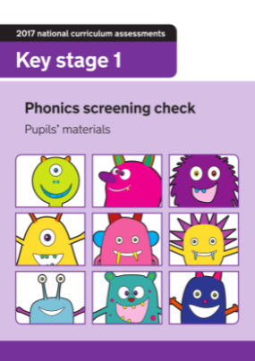
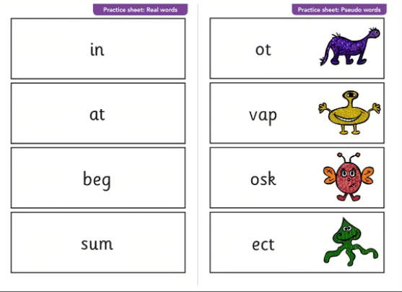
Assessment
Since 2012, all children have been assessed in Year One to determine whether they have learnt phonic decoding to an appropriate standard. This is called the Phonics Screening Check.
They are asked to read forty words, twenty real and twenty nonsense words.
© Oxford University Press 2021
Notes:
Overview of Essential Letter and Sounds and how it works
Resources – what they are and how they are used
Assessment and Intervention – what does this look like and how is it implemented
Next Steps – what happens next!
We will check the questions in the chat box at the end of the session so there will be plenty of time to answer and queries then

Slide 37
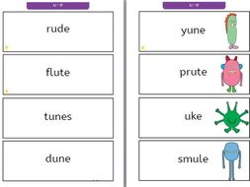
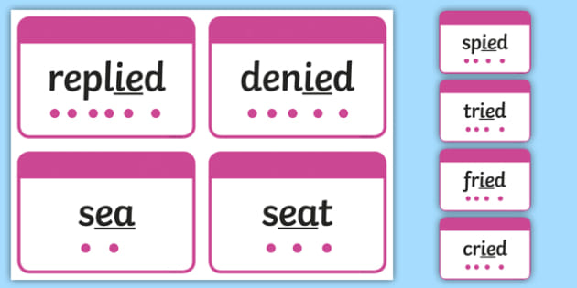
The children can add sound buttons to help them segment and then blend.
Your child’s screening score will be shared on their end of school report. If they do not achieve the pass rate score they can re-sit in Year 2.
Useful Tips
Make up nonsense words using the sounds already taught. E.g. vaib
Ensure your child decodes these words out loud for accuracy.
In the screening check, these words will have a picture or an alien alongside to remind the children they are a nonsense word.
© Oxford University Press 2021
Notes:
Overview of Essential Letter and Sounds and how it works
Resources – what they are and how they are used
Assessment and Intervention – what does this look like and how is it implemented
Next Steps – what happens next!
We will check the questions in the chat box at the end of the session so there will be plenty of time to answer and queries then

Slide 38


