Slide 1
Year 1 Information

Slide 2

2025 - 26

Slide 3
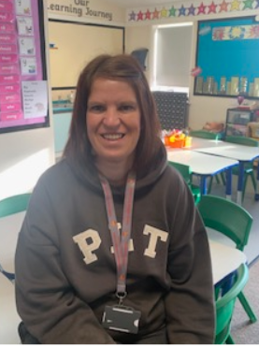


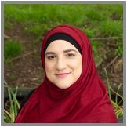
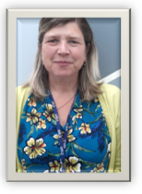
Our Team
Mrs Bull and Mrs Rashid will be covering PPA on Mondays.

Slide 4

Class Dojo & Our school website
Please feel free to contact us via class dojo if you have any questions. We will respond between the hours of 8am – 6pm.
If your child is away from school or your message is timely and important please phone our school office – 01332 691351
We will be putting the skills and vocabulary mats available on our school website for this term.
https://www.homefields.derby.sch.uk/page/?title=Autumn+1+%2D+The+Circus+is+in+Town&pid=134

Slide 5
Our Topic based approach to learning
Our school delivers a skills based thematic Curriculum, which is designed to teach all of the national curriculum content for their year group alongside the L2L attitudes and skills which the children need for life long learning. We do this through interesting and fun topics.
Our topics this year are:
Autumn - The Gruffalo, Light and Dark
Spring- Where in the world are we?, Toys
Summer- Up, up and away, Chocs away
Our topics rotate over a two year cycle. Before each topic, we share the learning overview and new vocabulary with parents on our school website.
Notes:
Our skills based Curriculum is designed to teach all the skills and attitudes the children need for life long learning through interesting and fun topics.

Slide 6
Our Learn 2 Learn attitudes.
At Homefields we believe that children need skills which will support not only their learning within school but their life beyond the classroom. Our Learn 2 learn attitudes are the attitudes and skills we believe they will need. We teach these explicitly and they are embedded into our learning activities. Your child will receive house team points for showing these skills during the school day.
The 6 R’s:
Responsible
Resourceful
Resilient
Respect
Reciprocal
Reflect

Slide 7
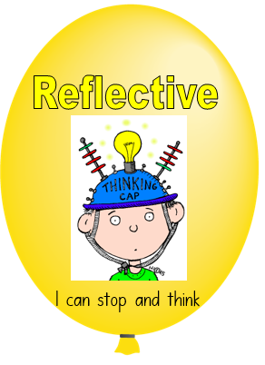






Slide 8

Skills
Every child in our class is working at different levels, to ensure each child has the opportunity to reach their full potential we differentiate the work within all of our subjects
These include:-
  Art, Science, Design & Technology, History, Computing, Geography, PSHE, P.E, R.E and Music

Slide 9

Mental Health and Well-Being
Our school was recently accredited with our Bronze School mental health award. We are continuing to strive to achieve the next level.
We care about the mental health and well-being of our children and spend time teaching children about emotions, ways to solve problems and how to communicate with adults for support and with each other. The children are able to post worries into our school ‘Worry box’ which is collected and supported by our Well-being coaches.
We also take part in mindfulness activities each week to help us regulate our breathing and find time to just be.

Slide 10

Snacks and Water
The children need to bring a water bottle to school everyday.
School are supplied with free fruit but the children can also bring ‘Healthy snacks’ from home.
We are a nut free school which includes foods like Nutella which are nut based.
Friday children can bring in a small treat snack e.g. small snack size chocolate bar or mini bag of sweets, please be mindful that children cannot share snacks and find concentration after large snacks too difficult.

Slide 11

PE
The children arrive in their PE kits on their PE day.
Our PE days are:
Mrs Chaudry’s – Monday and Thursday
The children can come to school wearing trainers.
No earrings
Girls long hair tied up
If your child wears religious jewellery please notify a member of staff who will speak with you.

Slide 12

We are an OPAL School- A program, which uses open-ended, natural, and upcycled resources—like tyres, planks, and mud kitchens—to create rich, imaginative, and inclusive play experiences for children.
This programme moves beyond traditional static equipment to foster crucial life skills, creativity, social development, and well-being, allowing children to lead their own adventures and make play a vital, enjoyable part of their day.
Children are therefore able to access the whole outdoor space during lunchtime to engage in play. We ask parents to ensure their child has waterproof clothing and wellies in school at all times.
We have a wellies rack in the year 1 garden so children can place their wellies there. Please ensure the wellies are labelled with your childs name.

Slide 13

Phonics
The children will be continuing on from Reception with our Phonics scheme called ‘Essential Letters and Sounds’. This scheme teaches the children phase 2-5. (FS2 & Y1)
The children will take part in a phonics lesson every day and will practise reading decodable books alongside their lessons.
To listen to the correct pronunciation of the phonemes please visit our website.

Slide 14

Reading
Reading is incredibly important at this age, not only reading their own books but also having stories read to them. It develops imagination, an ability to understand and interpret (inference) and a love of books. Many messages and morals are written within stories which we love to hunt for in class.
Your child’s reading day will be written in the front of their reading record.

Slide 15

Reading
As part of our new phonics scheme your child will come home with a book which consolidates the phonic sounds taught that week.
They will also come home with either another phonic book to support their blending and fluency or a family reading book. (VIPER book)

Slide 16

Family reader (VIPER)
These are books from our bookcase which do not match our phonics scheme and are not phonetic.
The parent/carer will read the book to the child and discuss the story, characters, events, make predictions and retell the story at the end. These books help to develop the children’s comprehension skills.

Slide 17

VIPERS
V – Vocabulary
I – Inference
P – Prediction
E – Explain
R – Retrieve
S – Sequence.
You will receive a bookmark with questions relating to each of these skills which you could ask whilst reading the story together.

Slide 18
Shared Reading
As well as individually hearing your child read every other week they will take part in shared reading within the classroom. The whole class will look at a range of texts or stories together and will work on their VIPER skills. Shared read develops their understanding of vocabulary and comprehension skills.
More information about Reading VIPERS will be in your packs sent home.

Slide 19
Reading & Homework Overview
Reading books | Books will be changed on your child’s reading day. Please refer to your child’s reading record or reading wallet to find out your child's reading day.
 | Please try and keep your child’s reading book in their book bags throughout the week.
Spellings | Given out half termly and tested on a Friday. The date of the quiz can be seen on the spelling sheet.
Homework | Given out on a Thursday and handed in for the following Thursday

Slide 20
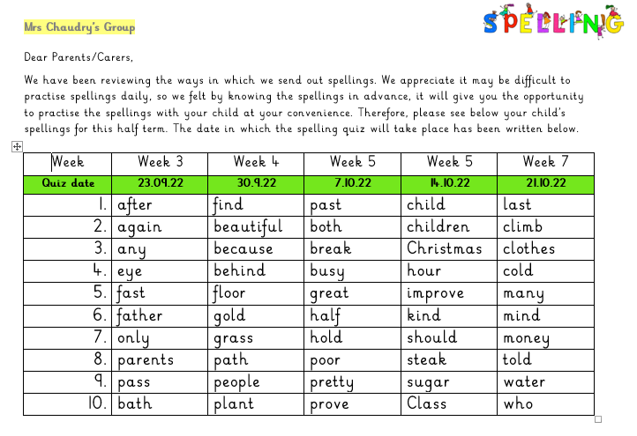
Spellings

Slide 21
Assessment
The children are constantly monitored and assessed in their learning and understanding in Year 1.
Each term we assessed the children in:
  Writing
  Reading and Comprehension
  Maths
  Science
  Foundation subjects (e.g. Geography, History, R.E)

Slide 22
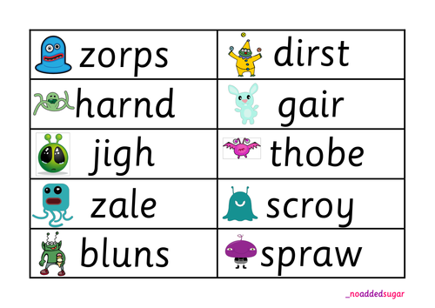
Phonics screening
The Year 1 children take part in a Phonics screening check in June 2025. This involves them reading 40 real and non-real words across phase 2-5.
We practise these skills within our daily phonics lessons and will keep you updated about their progress.
Their results from the June screening will be shared on their school reports in July.

Slide 23
Progress
During parent meetings we will share your child’s progress towards the end of year 1 standards.
The handouts provided will share more information about what they will be working on this year.
Their school report in July will share their final Year 1 levels. These will be working towards the Year 1 standard, working at the expected standard or exceeding the Year 1 standard.
Every child is different!
We will be inviting parents to come in and look at their child’s books at the end of term. Please see class dojo for our Circus event and book look dates and times.

Slide 24
Reading Ideas
Practising reading High Frequency words both reading and spelling.(see handouts)
Practising reading common exception words.
This could be by hiding words around the house and hunting for them. Writing words on paper outside and bouncing balls on top of them. Writing the words on two pieces of paper and playing matching pairs or snap. Having a word a day.
Reading a couple every time you hear them read.
Reading magazines, maps, recipes, information in shops, and whilst out on day trips.
If reading isn’t your child's most favourite activity then break it into smaller steps. They could read one page a day and you read a page. They could talk the story first by looking at the pictures to get a good idea about the events which will then support their reading.
Phonics play website - https://www.phonicsplay.co.uk/ Great for phonics games to play.
Oxford Owl provides online reading books https://home.oxfordowl.co.uk/reading/

Slide 25

Maths
Please see the hand out sheets which explain the skills your child will be working towards this year.
Idea’s to support Maths out of school
Count objects – at home, e.g. forks in the drawer, teddies on the bed. Out and about, birds at the park, leaves collected on an autumn walk. Encourage your child to write the number.
Practise correct formation of numbers – in the bath water, in salt dough, with chalks outside, in washing up foamy bubbles, on whiteboards or paper.
Incorrectly write numbers and encourage your child to teach you the correct way.
Order numbers – write numbers on paper and ask your child to lay them out correctly.
Talk about the placement of objects to secure positional language e.g. behind, on top, next to, in between, opposite, on the left or right.
Look at numbers in shops with price tags,
Identify and sort coins – if you have spare change or a money box empty it out and together sort the coins into groups (1p, 2p, 5p) Identify there is no 3p and 4p.
Make price tickets and use the coins to make simple prices e.g. 6p
Look at the clock and begin to recognise the numbers around the clock face. Show the children what time they leave the house in the morning and begin to use the words o’clock.
Weigh out ingredients together if you’re baking and begin to compare the weight of objects in the house by holding one in each hand.
Capacity - Fill containers in the bath water full, half full and empty. Or fill a glass full of water and recognise when it is full, half full and empty.
Fractions – whilst cutting and preparing food talk about half and quarters They may like their sandwiches/pizza cut into half or quarters. Begin to use this language.
Shape – Go for a shape hunt around the house to find – triangles, circles, rectangles, squares, or 3D shapes – cube, cuboid, pyramid, sphere, cylinder and cones.
Maths can be made fun anywhere – counting their jumps on a trampoline can be counting in 1’s or in 10’s. e.g. 10, 20,
Learning does not need to take place at tables and children often enjoy and remember the activities when it is linked to real life experiences.

Slide 26

Writing Ideas
Writing a card to a friend
Writing a message to someone – this could be on small paper which they can then hide/give to the person.
Practising writing high frequency words in sand, water, bubbles or on paper.
Practising alphabet letters – tracing these with their finger, driving cars around them like a race track. This will help imprint the correct formation into their memory before asking them to write.
Practising pencil grip – pinching the pencil between their first finger and thumb and sitting all other fingers underneath. Painting – practising pencil grip whilst holding a paintbrush.
Colouring – practising control of a pencil crayon and staying within the lines.
Writing invitations for teddy’s to come to a tea party
Writing a letter to someone and posting it to them.
Playing school teacher and teaching a family member how to correctly write letters.
Practising phonic sounds (These will be sent home)
Practising using finger spaces between words.
Writing their first name correctly.

Slide 27
Thankyou for coming to our meeting

