Slide 1
Year 1 and 2 Information

Slide 2
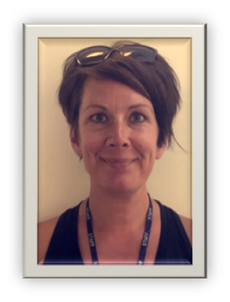
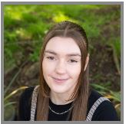
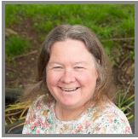
Our Team
Mrs Jamieson teaches the class Monday afternoons.

Slide 3

Class Dojo & Our school website
Please feel free to contact us via class dojo if you have any questions. We will respond between the hours of 8am – 6pm and within 24 hours.
If your child is away from school or your message is timely and important please phone our school office – 01332 691351
We will be putting the skills and vocabulary mats available on our school website for this term.
https://www.homefields.derby.sch.uk/page/?title=Autumn+1+%2D+The+Circus+is+in+Town&pid=134

Slide 4
Our Topic based approach to learning
Our school delivers a skills based thematic Curriculum, which is designed to teach all of the national curriculum content for their year group alongside the L2L attitudes and skills which the children need for life long learning. We do this through interesting and fun topics.
Our topics this year are:
Autumn – The Circus is in Town, Polar Adventure
Spring – Fun Food Factory, Dinosaurs and all that Rubbish!
Summer – The Seaside, The Great Fire of London
Our topics rotate over a two year cycle. Before each topic, we share the learning overview and new vocabulary with parents on our school website.
Notes:
Our skills based Curriculum is designed to teach all the skills and attitudes the children need for life long learning through interesting and fun topics.

Slide 5
Our Learn 2 Learn attitudes.
At Homefields we believe that children need skills which will support not only their learning within school but their life beyond the classroom. Our Learn 2 learn attitudes are the attitudes and skills we believe they will need. We teach these explicitly and they are embedded into our learning activities. Your child will receive house team points for showing these skills during the school day.
The 6 R’s:
Responsible
Resourceful
Resilient
Respect
Reciprocal
Reflect

Slide 6
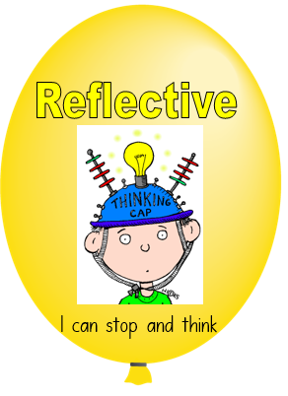






Slide 7
School values
Be kind
Be courageous
Be respectful
During and outside of learning times, we are always encouraging our children to be kind, courageous and respectful. This is rewarded with housepoints, certificates and stickers.

Slide 8

Individual support
Every child in our class is working at their own level and pace. To ensure each child has the opportunity to reach their full potential, we differentiate the work within all of our subjects where necessary.
These include:-
  Art, Science, Design & Technology, History, Computing, Geography, PSHE, P.E, R.E and Music

Slide 9

Mental Health and Well-Being
Our school has been accredited with a Bronze School mental health award. We are continuing to strive to achieve the next level.
We care about the mental health and well-being of our children and spend time teaching children about emotions, ways to solve problems and how to communicate with adults for support and with each other.
We also take part in mindfulness activities each week to help us regulate our breathing and find time to just be.

Slide 10
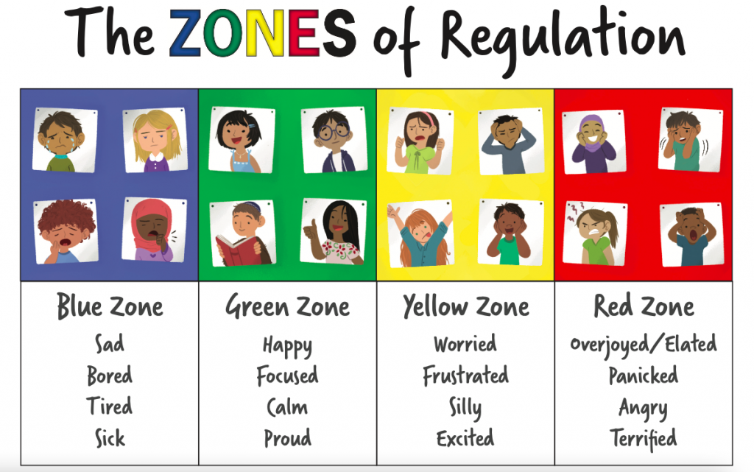

Slide 11

Snacks and Water
The children need to bring a water bottle to school everyday.
School are supplied with free fruit but the children can also bring ‘Healthy snacks’ from home.
We are a nut free school which includes foods like Nutella which are nut based.
Friday children can bring in a small treat snack e.g. small snack size chocolate bar or mini bag of sweets, please be mindful that children cannot share snacks and find concentration after large snacks too difficult.

Slide 12

PE
The children arrive in their PE kits on their PE days.
Our PE days are: Monday and Friday
No earrings
Girls long hair tied up
If your child wears religious jewellery please notify a member of staff who will speak with you.

Slide 13
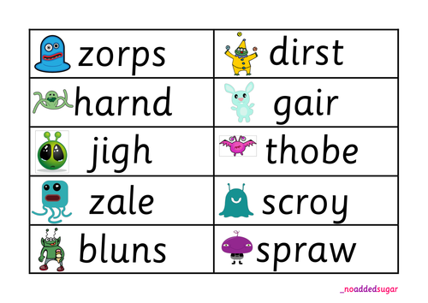
Phonics screening
The Year 1 children take part in a Phonics screening check in June 2025. This involves them reading 40 real and non-real words across phase 2-5.
We practise these skills within our daily phonics lessons and will keep you updated about their progress.
Their results from the June screening will be shared on their school reports in July.

Slide 14

Phonics
The Phonics scheme we use at Homefields is called ‘Essential Letters and Sounds’. This scheme teaches the children phase 2-5.
Year 2 who did not pass their Year 1 screening or who would benefit in their reading and writing from revisiting phonics will be receiving daily phonics teaching this year.
To listen to the correct pronunciation of the phonemes please visit our website.
Phonics | Homefields Primary School
Children that did not pass will retake their Screening Check in June 2025.

Slide 15
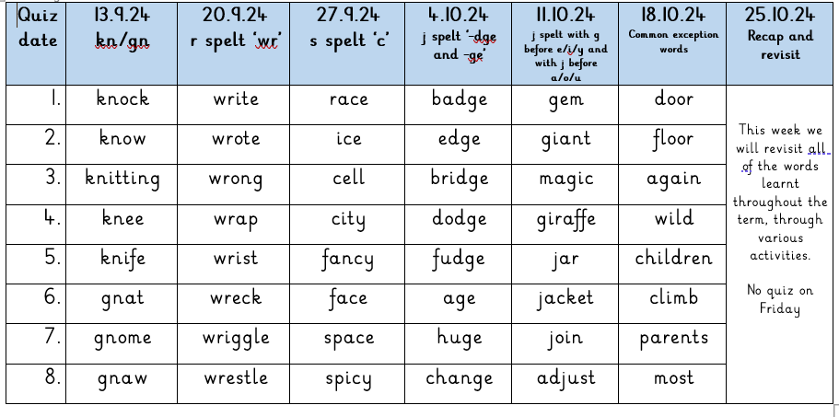
Daily Phonics/Spellings
Children will be in an appropriate phonics/spelling group
Children will have daily sessions in these groups
They will have some spelling homework each week, the sheet has a whole half term of spellings on it and the children will complete a quiz each ‘Friday’. These will be phonic sounds or spelling rules which have been taught and explored in their groups.

Slide 16

Reading
Reading is incredibly important at this age, not only reading their own books but also having stories read to them. It develops imagination, an ability to understand and interpret (inference) and a love of books. Many messages and morals are written within stories which we love to hunt for in class.
Please record any reading at home in your diary so that we can work together to support reading and instill a love for books too

Slide 17

Reading
If your child is still working through the phonetically decodable books we will continue to support this alongside an alternative VIPER ‘family book’.
These are books from our bookcase which do not match our phonics scheme and are not always phonetically decodable.
The parent/carer will read the book to the child and discuss the story, characters, events, make predictions and retell the story at the end. These books help to develop the children’s comprehension skills.

Slide 18
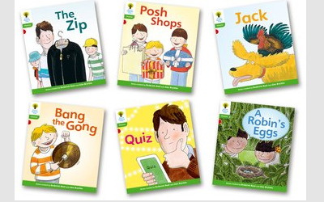

Oxford Owl Books
Children who have successfully completed the Phonics scheme will be moving away from the ELS books and onto Oxford Owl books. The books are organised into levels and colour.
Oxford owl have a range of different books and the covers vary.

Slide 19
Shared Reading
As well as individually hearing your child read every other week they will take part in shared reading within the classroom. The whole class will look at a range of texts or stories together and will work on their VIPER skills. Shared reading develops their understanding of vocabulary and comprehension skills.

Slide 20
Reading & Homework Overview
Reading books | Books will be changed on your child’s reading day. Please refer to your child’s reading record or reading wallet to find out your child's reading day.
 | Please try and keep your child’s reading book in their book bags throughout the week.
Spellings | Given out half termly and tested on a Friday. The date of the quiz can be seen on the spelling sheet.
Homework | Given out on a Thursday and handed in for the following Thursday

Slide 21

Maths in school
As a school we base our Maths planning on the White Rose Scheme.
It allows us to explore different elements of maths throughout the year.
We have started with place value
In school we will encourage all children to have a go using resources and concrete examples to support their maths and understanding
As they develop these skills we will then support them in trying to solve problems within mathematics.

Slide 22

Maths
Please see the hand out sheets which explain the skills your child will be working towards this year.
Idea’s to support Maths out of school
Count objects – at home, e.g. forks in the drawer, teddies on the bed. Out and about, birds at the park, leaves collected on an autumn walk. Count in 1’s, or group and count them in 2’s, 5’s or 10’s Encourage your child to write the number.
Practise correct formation of numbers – in the bath water, in salt dough, with chalks outside, in washing up foamy bubbles, on whiteboards or paper. Check the height of numbers and try to be consistent in size.
Order numbers – write numbers on paper and ask your child to lay them out correctly. This may be consecutive numbers e.g. 31, 32, 33, 34 or random numbers 10, 7, 58, 91, extending to the hundreds if your child would like a challenge.
Talk about the placement of objects to secure positional language e.g. behind, on top, next to, in between, opposite, on the left or right.
Turns – Whilst on the trampoline practise making whole turns, half a turn, quarter turns, clockwise and anti-clockwise. Alternatively spin a teddy on the carpet.
Look at numbers in shops with price tags, identify pound and pence signs. Identify which price is the greatest or the least.

Slide 23
Maths Ideas
Identify and sort coins – if you have spare change or a money box empty it out and together sort the coins into groups (1p, 2p, 5p) Identify there is no 3p and 4p.
Make price tickets and use the coins to make simple prices e.g. 6p, 12p, 45p, 79p, or £1.25
Look at the clock and begin to identify o’clock times. Show the children what time they leave the house in the morning and begin to use the words o’clock, half past, quarter to and quarter past.
Weigh out ingredients together if you’re baking and begin to compare the weight of objects in the house by holding one in each hand. Look for the weight on the backs of tins and bags and read these, recognising g = grams. Kg = kilograms.
Capacity - Fill containers in the bath with water. Make them full, half full and empty. Use measuring jugs to pour out liquids and know that we measure liquids using ml= millilitres and l = litres.
Length – Use objects to measure the length of items in your home e.g. it was 5 pencils long. Use a ruler to measure more accurately knowing where to begin. Know that m = metres and cm = centimetres. Draw lines that are 7cm, 10cm or 15cm long.

Slide 24

Writing Ideas
Writing a card to a friend
Writing a message to someone – this could be on small paper which they can then hide/give to the person.
Practising writing high frequency words in sand, water, bubbles or on paper.
Practising alphabet letters – tracing these with their finger, driving cars around them like a race track. This will help imprint the correct formation into their memory before asking them to write.
Practising pencil grip – pinching the pencil between their first finger and thumb and sitting all other fingers underneath. Painting – practising pencil grip whilst holding a paintbrush.
Colouring – practising control of a pencil crayon and staying within the lines.
Writing invitations for teddy’s to come to a tea party
Writing a letter to someone and posting it to them.
Playing school teacher and teaching a family member how to correctly write letters.
Practising phonic sounds (These will be sent home)
Practising using finger spaces between words.
Writing their first name correctly.

Slide 25
Assessment
The children are constantly monitored and assessed in their learning and understanding in Year 2.
Each term we assess the children in:
  Writing
  Reading and Comprehension
  Maths
  Science
  Foundation subjects (e.g. Geography, History, R.E)

Slide 26
SATs
You may have noticed that the Government announced that the KS1 SATs are no longer statutory. Therefore we will no longer be submitting data to the local authority.
We will be assessing the children’s reading and maths skills to ensure our teacher judgements are secure for when they enter KS2.
This may be in the style of a mocks paper towards the end of the academic year.

Slide 27
School trips and enrichment
We look forward to welcoming you to school for celebrations throughout the year – including at the end of our circus topic, with a circus show performance on Thursday 10th October.
We hope to support our learning this year with a trip in Summer 2, most probably around June.
We also hope to have some sessions in school with external visitors – RE focus.
We also have tentative plans for an exciting seaside day in Summer 1where we may ask for a small donation of £2 to support with resources.

Slide 28
Thankyou

