Slide 1

YEAR 6 AT HOMEFIELDS

Slide 2
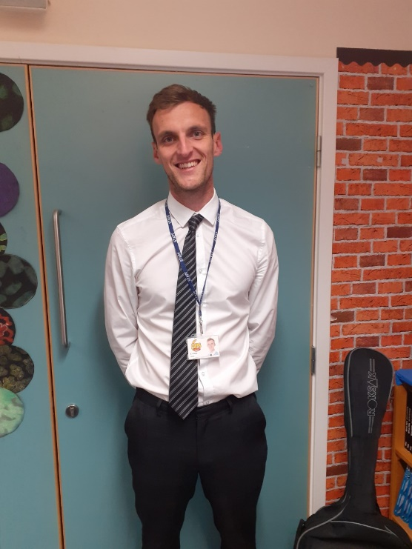
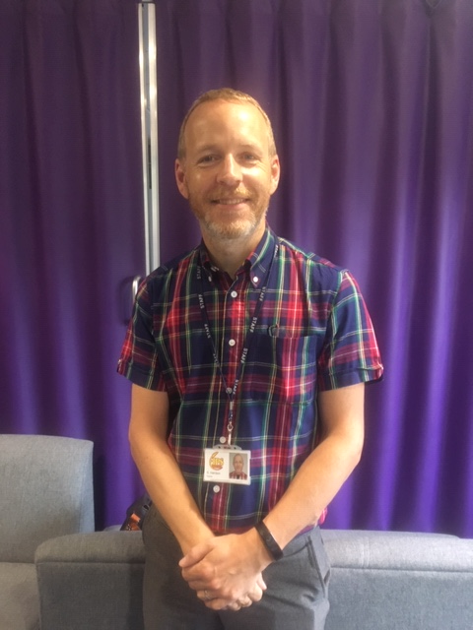
Teachers
The two year 6 classes are taught by Mr Harrison and Mr Hales

Slide 3
School Uniform
Please follow this link to our school website to find information about school uniform:
https://primarysite-prod-sorted.s3.amazonaws.com/homefields-primary-school/UploadedDocument/71503b8451ea496d8fa4e2f2d7a82f5e/homefields-primary-school-checklist.docx.pdf

Slide 4
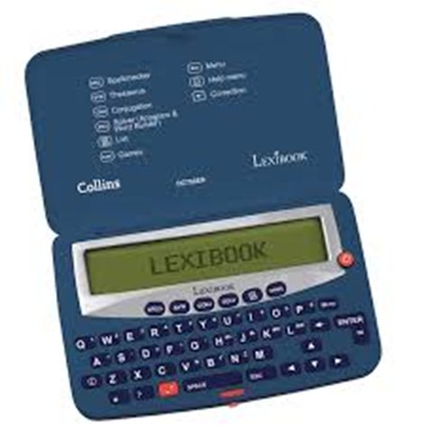
Equipment needed
Pencils of decent quality (HB)
Fountain pen or roller ball in blue
Black pen for up-levelling
A dry-wipe pen for whiteboard work
Rubber
Glue stick
30 cm ruler
Scissors
Colouring pencils/felt tips
A highlighter
Electronic spell-check/thesaurus (optional but really useful)
These should be named!

Slide 5




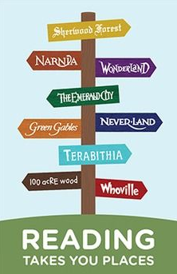
Reading
Notes:
Develop stamina to read longer novels
Be able to P.EE
Authorial intent

Slide 6
Children need to develop the skills to read with speed, stamina and understanding. It is important that children continue to read daily from a range of texts (fiction, non-fiction and poetry). In year 6, children will have a reading journal. The purpose of this is to encourage reading for meaning. In the journal, children will create a piece of writing after they have finished a book. This could be: a letter from a character; turning a chapter into a playscript; writing a review for a magazine or writing a detailed description of a setting. Any other ideas are welcome.
Key Reading Skills:
Scanning
Skimming
Retrieving
Summarising
Context clues
Inference

Slide 7
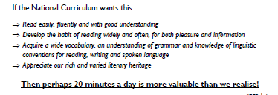

Slide 8
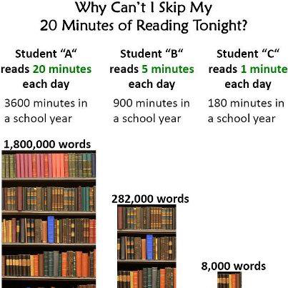
Get hooked on books!KGE

Slide 9
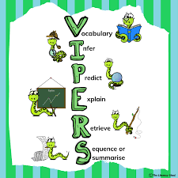

Slide 10
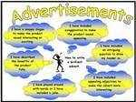
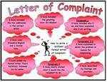
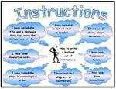
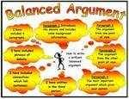
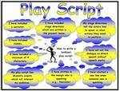
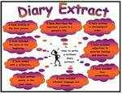


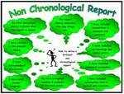
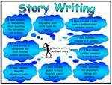
Writing
Throughout the year, year 6 children will practise writing from a range of genres (see above). These will often be based on a class novel. In the first half of the autumn term, year 6 will be reading ‘Kensuke’s Kingdom’ by Michael Morpurgo. It would be beneficial for all children to have their own copy of this novel to use during lessons. Writing is teacher assessed throughout the year.

Slide 11
The gloomy silhouettes suddenly disappeared, as the crescent moon was released from its prison. The light shone weakly onto the building opposite… just enough for the killer to search the derelict alleyway below him. The assassin gave a sinister grin, his shaggy dark coat hiding him from anyone who dared to enter his domain.
“Anytime now,” the murderer thought to himself.
He lay low in the darkness, his eyes fixed upon the street in which the unfortunate culprit would creep out onto, waiting for the moment when he would strike. Blood raced through his body, his pulse quickening with every moment that passed.
After what felt like an eternity, with his limbs aching, the building to the right of him began to shake, before long doing so more vigorously and emitting odd noises: GRACK! RACKT!
“Finally,” smiled the assassin, “my time to shine.”
Without warning, the noises abruptly came to a halt. Tensing his body, he steadied his legs, crouching low, preparing to pounce. And then…. out flew a piece of sewage.
“Dang it!” he wailed.
Now, more infuriated than he had ever been, he repositioned his body, determined to end this embarrassment of a murder.
He took a long, deep breath, cautiously scanning his surroundings, once again the gloom sweeping over him in a curtain of black. The victims suddenly appeared, oblivious to his whereabouts. Hovering above him, the assassin gave a smirk. Swoop! Rip!
“Easy as you like!” he laughed.
A dead rat lay on the cobbled street, the mud gradually oozing over the dry skin. With a sense of glee, the barn owl flew triumphantly back to its lookout, the rat dangling from his claws, as he readied for the feast ahead.

Slide 12
Children need to be responsible for editing and improving their work themselves! This is what the black pen is for. Year 6 children are responsible for completing and returning homework.

Slide 13

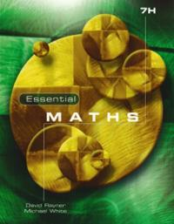

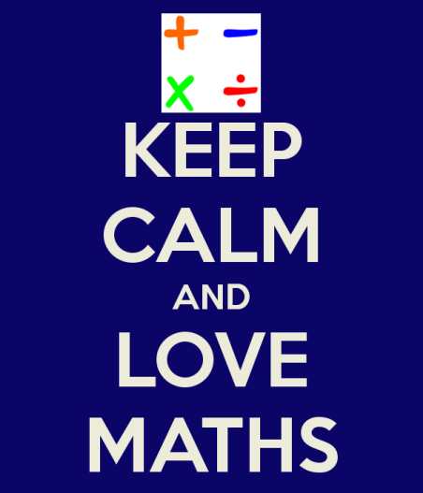
Numeracy
In year 6, children will continue to develop their arithmetic skills alongside problem solving and reasoning. It is important that children apply their mathematical knowledge and can explain their reasoning and methods. We shall begin the year by focussing on place value and number.

Slide 14

Extra help
Early morning numeracy
Maths and grammar surgeries
Finishing work at lunchtime
Individual or small group reading, spelling and comprehension support

Slide 15
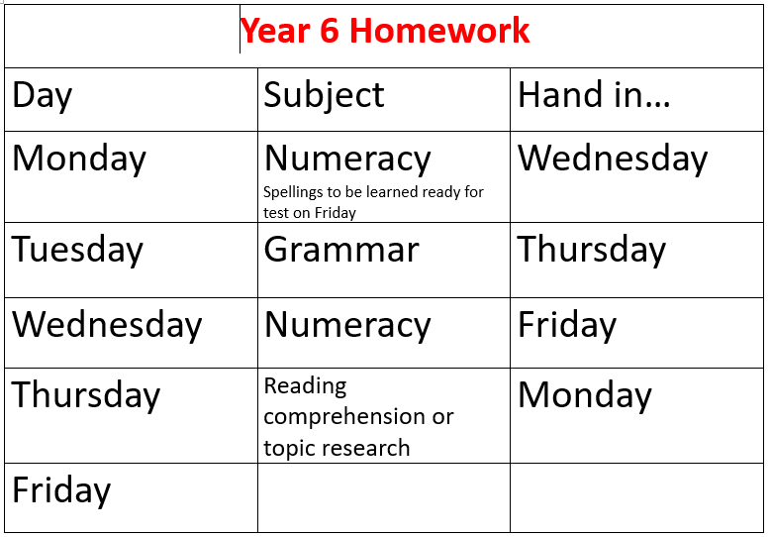
Homework

Slide 16
SATs
Monday 12th -Thursday 15th May 2025
SPAG
Reading
Maths (x3)

Slide 17
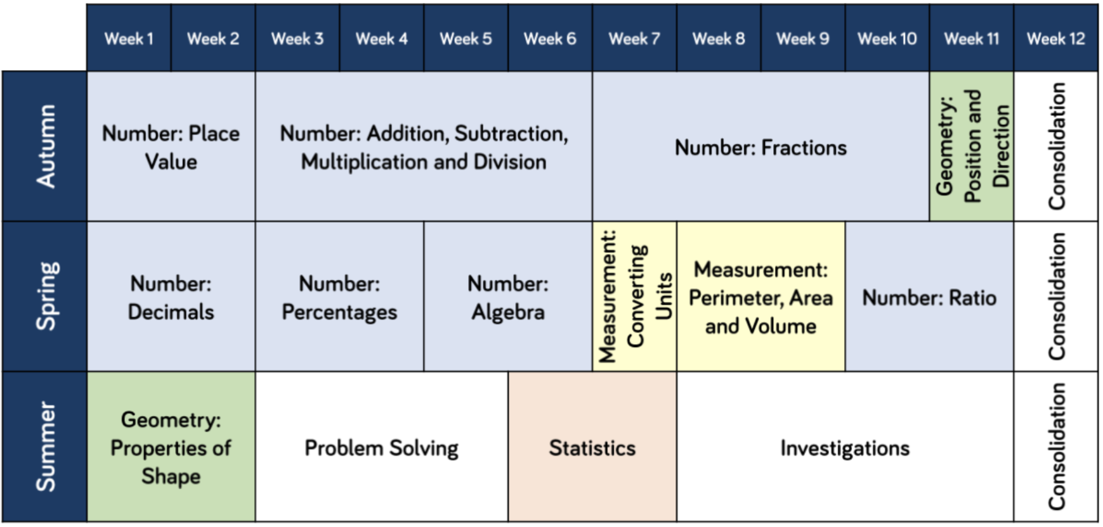
Calculation Workshop
On Thursday 19th September at 5.00 pm there will be a session to outline and explain the calculation methods that children will learn and develop in year 6. You are welcome to join us.

Slide 18
PE days
Mr Harrison’s Class – Monday and Tuesdays
Mr Hales’ Class – Mondays and Tuesdays
These days may change but we will inform you about this. Children will need to come to school in PE kit on these days.

Slide 19
Communication
Classdojo – teachers will reply between the hours of 8.00 am and 6.00 pm. We will only send messages or post on class story outside of these hours when absolutely necessary.
School Website – class pages for information about topics
E-mail is the main form of communication from the office – please check details are correct. Please inform the office of absence rather than through Classdojo.
Smart Watches with a photographic function – please avoid children wearing these to school.
Walking home permission

Slide 20
Trips!
Carsington – June 2025
Hollowford – 11th – 13th June 2025

