Slide 1
YEAR 5 AT HOMEFIELDS
Mr Harrison
Miss Clover

Slide 2
Equipment needed
2 HB pencils
Rollerball/ handwriting pens (blue and black ink) - not ballpoint whiteboard pens (we run out of these regularly) rubber
30cm clear ruler pencil sharpener glue stick (colours!) scissors protractor highlighters
Colouring pencils and felt tips

Slide 3
School Uniform
Please follow this link to our school website to find information about school uniform:
https://primarysite-prod-sorted.s3.amazonaws.com/homefields-primary-school/UploadedDocument/71503b8451ea496d8fa4e2f2d7a82f5e/homefields-primary-school-checklist.docx.pdf

Slide 4
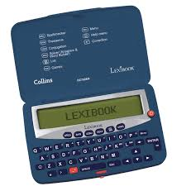
Desirable equipment
Electronic spell-checker with thesaurus
This will really support their writing.

Slide 5
P.E. Days Autumn Term
P.E. (Please come to school in P.E. clothes)
Mr Harrison – Monday and Tuesday
Miss Clover – Wednesdays and Fridays
Please refer to the dress code information.

Slide 6
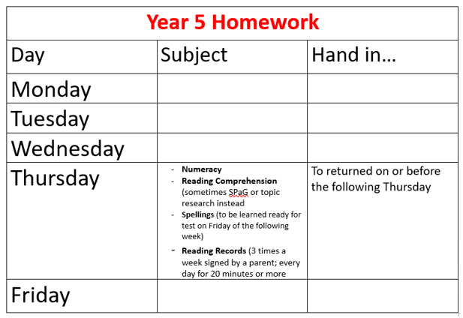

Slide 7





Reading
Notes:
Develop stamina to read longer novels
Be able to P.EE
Authorial intent

Slide 8
Children need to develop the skills to read with speed, stamina and understanding. It is important that children continue to read daily from a range of texts (fiction, non-fiction and poetry).
Key Reading Skills:
Vocabulary
Inference
Predict
Explain
Retrieve
Summarise

Slide 9


Slide 10
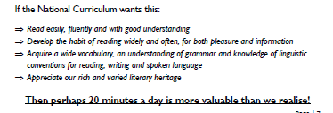

Slide 11

Get hooked on books!KGE

Slide 12


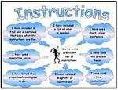
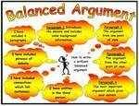
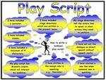
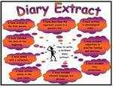


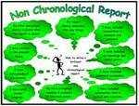

Writing
Throughout the year, year 5 children will practise writing from a range of genres (see above). These will often be based on a class novel. In the first half of the autumn term, year 5 will be reading ‘Kensike’s Kingdom’ by Michael Morpurgo. It would be beneficial for all children to have their own copy of this novel to use during lessons. Writing is teacher assessed throughout the year.

Slide 13
Children need to be responsible for editing and improving their work themselves! This is what the black pen is for. Year 5 children are responsible for completing and returning homework.

Slide 14
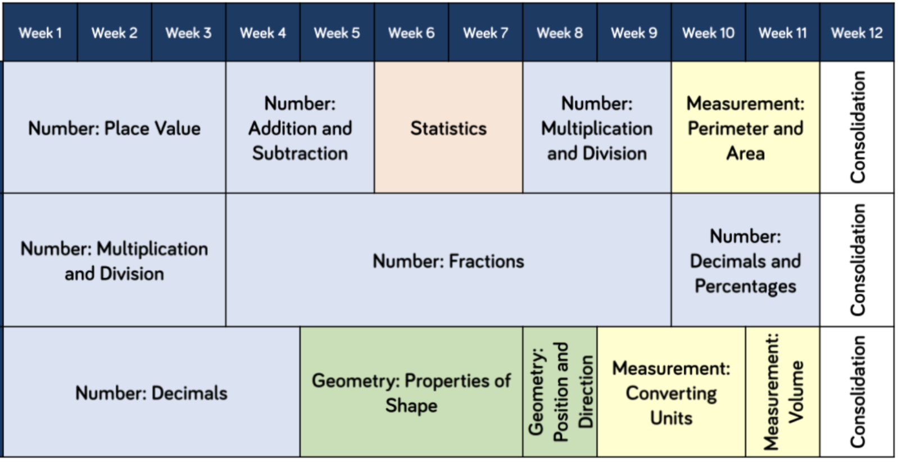
Calculation Workshop
On Thursday 19th September at 4.00 pm there will be a session to outline and explain the calculation methods that children will learn and develop in year 5. You are welcome to join us.

Slide 15
PE days
Mr Harrison’s Class – Monday and Tuesdays
Miss Clover’s Class – Wednesdays and Fridays
These days may change but we will inform you about this. Children will need to come to school in PE kit on these days.

Slide 16
Communication
Classdojo – teachers will reply between the hours of 8.00 am and 6.00 pm. We will only send messages or post on class story outside of these hours when absolutely necessary.
School Website – class pages for information about topics
E-mail is the main form of communication from the office – please check details are correct. Please inform the office of absence rather than through Classdojo.
Smart Watches with a photographic function – please avoid children wearing these to school.
Walking home permission

Slide 17
Trips!
Carsington – June 2025 – geography

