Slide 1
Getting ready for Foundation Stage 1
Things to practise before starting nursery.

Slide 2
Aims
To suggest some tasks that your child could practise over the summer to make starting nursery less tricky.

Slide 3
To drink from a cup without a lid.

Slide 4
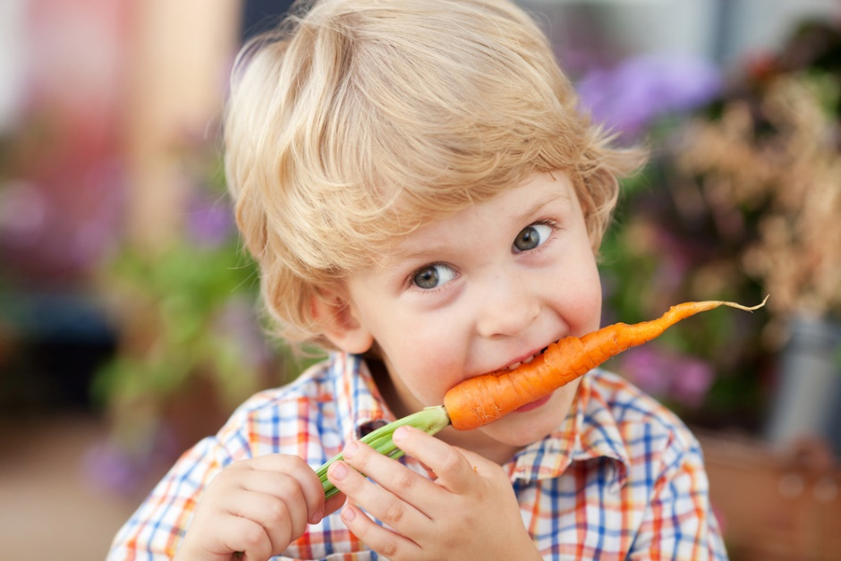
To eat a piece of fruit/vegetable that has not been peeled or cut up.

Slide 5
Open own lunch box and the food containers within it.

Slide 6
Put on and attempt to fasten a coat.

Slide 7
Put on and try to fasten own shoes.

Slide 8
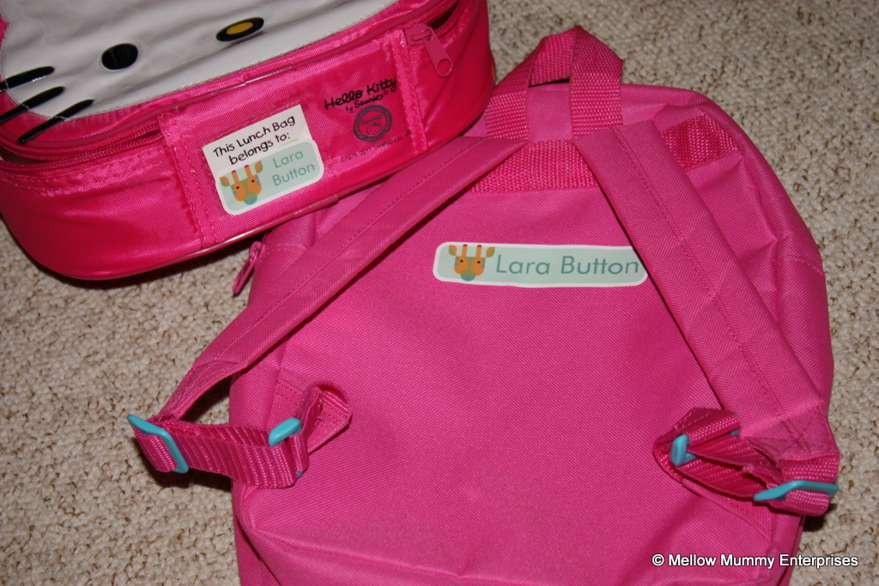
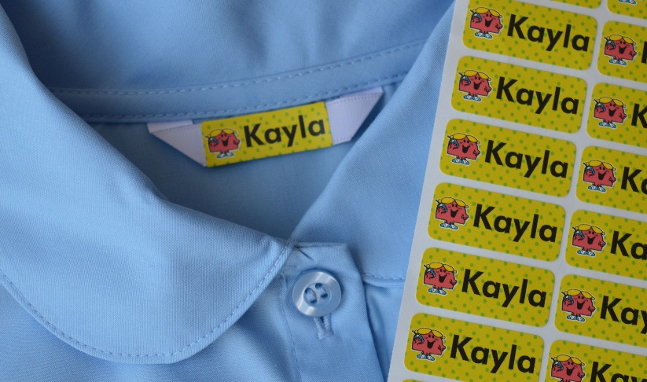
Recognise own name labels.

Slide 9
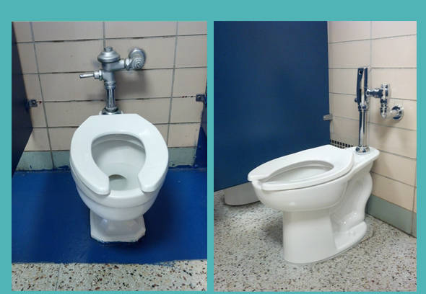
Going to toilet as independently as possible.

Slide 10
Washing hands properly with soap and water.

Slide 11
Familiarise your child with the school by going past it on your walks.

Slide 12
Talk about our feelings about starting nursery.
It is perfectly normal to have a range of feelings about starting nursery (both children and grown ups!)
Recognise these feelings and give your child chance to chat with you about it.
Try to shield your child from your own feelings if you are anxious or worried – children pick up on what you are feeling.
Try to find and focus on the things your child is looking forward to about nursery.

Slide 13
Think about all the fun things your child can do at nursery.

