Slide 1
Foundation Stage 1
Information meeting for children starting in
September

Slide 2
Aims of this power point
To find out the information you need for your child starting Foundation Stage 1 in September.

Slide 3
Foundation Stage 1 Staff
Mrs Harris – Foundation Stage 1 Teacher
Mrs Lewis – Teaching Assistant
Mrs Holmes – Lunch time Teaching Assistant

Slide 4
Early Years Foundation Stage Framework
Play is integral to learning!
Plan creative, fun and challenging experiences and activities.
Plan accordingly to the needs and development of the children.
7 areas of learning
Learning will take place both indoors and outdoors every day.

Slide 5

Learning to Learn
Respect
Reciprocal
Resilient
Resourceful
Reflective
Responsible

Slide 6
Session Times
All day 8.55am – 3.25 pm
AM session – 8.55am – 11.55am
PM session – 12.25pm – 3.25pm
AM – doors open at 11.50am
PM – doors open at 3.20pm

Slide 7

Successful Transition
Staggered Intake.
Personal transition plan if necessary.
Have a positive outlook about this new chapter in your child’s life.
Talk to staff about any worries or concerns.

Slide 8
Safety
Indoor and Outdoor area is secure. External doors are locked.
DBS checks.
All staff and visitors will wear identification badges.
Security password.
16+ to collect child from nursery.
Risk assessments completed.
Paediatric First aider. (accident form and book)
Accidents recorded and reported.
Inform staff if someone different is collecting.

Slide 9
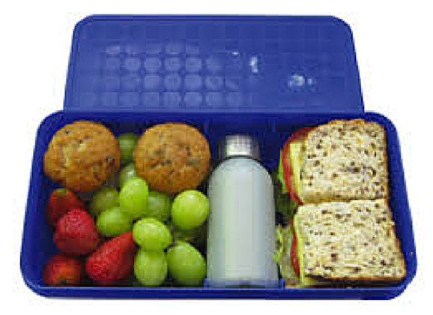
Lunch Times
At least 2 trained early years Teaching Assistants will supervise the children.
The children will eat in the nursery.
Lunch time is 11.50-12.30.
Children must bring a packed lunch - NO NUTS or NUT based products!
- No fizzy drinks.
- No hot food/drinks.
- Nutritious lunch.
- Child sized portions.
Lunch boxes and water bottles need to be clearly labelled with a name.

Slide 10

Snack time
The children will have snack time every day, once in the morning session and once in the afternoon session.
Milk or water is provided by the school. No need to bring a water bottle for snack)
Fresh fruit or vegetables are provided by the school.
Occasional Treats may be provided by the school for special occasions.
Staff must be informed of any food or drink that must be avoided due to allergies or religious beliefs.

Slide 11
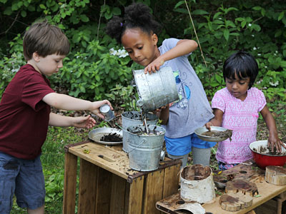
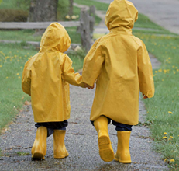

Clothing
Name all items! It is very easy for items to get lost in nursery if not named.
Clothes that can get wet or mucky during play. Please do not send your child in clothes that they cannot get dirty.
Children must wear clothes that they can move about comfortably in.
Footwear that is safe for your child to run, climb and jump in.
Weather appropriate clothes, coats and shoes.

Slide 12
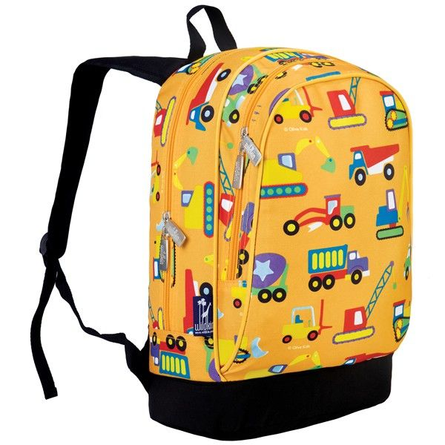
Contents of bag
Your child must bring a bag every day with them to nursery. Inside this bag must be :
Spare set(s) of clothes – trousers/skirts, tops, jumper.
Socks, vests and pants
Wipes
Carrier bag (tied in a knot)
Hat, scarf, mittens/ sun hats.
Please Do NOT send in dummies,
toys, food or drink.

Slide 13
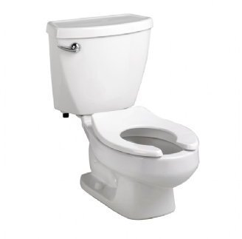
Toileting
Most children at 3 will be toilet trained.
Health Visitor can help if you are struggling.
Encourage your child to be independent with self-care, practise during the summer months.
Send your child in clothes that are easy to take off/ pull down. (not skinny jeans, dungarees, belts etc)
Lots of spare clothes in bag.
If your child has a toileting accident – a member of staff will help child to change and a note will be sent home to you along with the wet clothes.

Slide 14

Illness
If your child is poorly….it is best to keep them at home.
Staff will contact parents/carers if child becomes unwell.
Emergency contact details must be kept updated.
Staff must be made aware of any medical needs or allergies that your child has.

Slide 15



Sharing information
Termly newsletter – emailed to you and on school website.
School bulletin – emailed to you.
Dojo – used to share information and to give examples of what we have been doing in nursery eg photo of a display
Parents meetings – October and February.
Reports – July.

Slide 16
Other information
Trips – permission will be sought, risk assessments will be carried out.
Special events – we try to make sure that these take place on different days of week to ensure part time children can access at least some of them.

Slide 17

Makaton

Slide 18
Purpose of visit day
To meet the Foundation Stage 1 team.
To see the nursery environment where your child will be.
To familiarise your child with the nursery environment. Eg – helping them to find and use the toilet.
To help your child meet and play alongside their new classmates. Learning a name or two can really help the transition in September.
To allow staff to check through admission form information with parents.
To allow staff to take your child’s photo so labels can be made ready for your child’s first day.
To allow parents to ask any questions they my have.

Slide 19
School Admissions
Parents will be given a form when it is time to apply for a school place.
Just because a child attends Homefields Nursery it
does not mean that they will automatically be given a place at Homefields Primary School.

