Slide 1
Calculation Methods
for Year 5

Slide 2
At Homefields, we use ‘Concrete, Pictorial, Abstract’ (CPA) which is a highly effective approach to teaching that develops a deep and sustainable understanding of maths in pupils.
Concrete step of CPA
Concrete is the “doing” stage. During this stage, students use concrete objects to model problems. Unlike traditional maths teaching methods where teachers demonstrate how to solve a problem, the CPA approach brings concepts to life by allowing children to experience and handle physical (concrete) objects. With the CPA framework, every abstract concept is first introduced using physical, interactive concrete materials.
For example, if a problem involves adding pieces of fruit, children can first handle actual fruit. From there, they can progress to handling abstract counters or cubes which represent the fruit.
Concrete
Pictorial
Abstract
4 + 3 =
4
+
3

Slide 3
Pictorial step of CPA
Pictorial is the “seeing” stage. Here, visual representations of concrete objects are used to model problems. This stage encourages children to make a mental connection between the physical object they just handled and the abstract pictures, diagrams or models that represent the objects from the problem.
Building or drawing a model makes it easier for children to grasp difficult abstract concepts (for example, fractions). Simply put, it helps students visualise abstract problems and make them more accessible.
Concrete
Pictorial
Abstract
4 + 3 =
4
+
3

Slide 4
Abstract step of CPA
Abstract is the “symbolic” stage, where children use abstract symbols to model problems. Students will not progress to this stage until they have demonstrated that they have a solid understanding of the concrete and pictorial stages of the problem. The abstract stage involves the teacher introducing abstract concepts (for example, mathematical symbols). Children are introduced to the concept at a symbolic level, using only numbers, notation, and mathematical symbols (for example, +, –, x, /) to indicate addition, multiplication or division.
Concrete
Pictorial
Abstract
4 + 3 =
4
+
3

Slide 5
Expectation in Year 5
Addition: Add numbers with more than 4 digits(including money, measures and decimals with a different number of decimal places)
Subtraction: Subtract with at least 4-digit numbers (including money, measures and decimals)
Multiplication: Multiply up to 4-digit numbers by 1 or 2 digits (introduce column multiplication)
Division: Divide up to 4 digits by a single digit, including those with remainders (chunking leading into short division method)

Slide 6
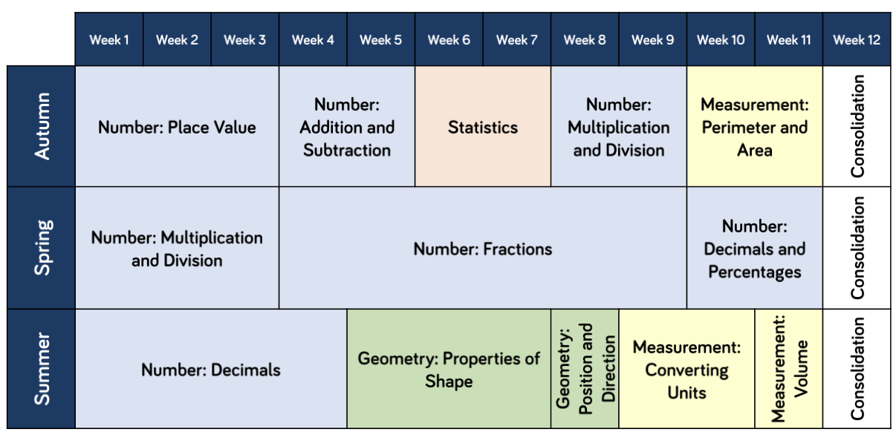

Slide 7
Addition: Add numbers with more than 4 digits (including money, measures and decimals with a different number of decimal places)
£ 2 3 . 5 9
+ £ 9 . 6 4
3 5 7 4 6
+ 7 4 3 8
£ 3 3 . 2 3
4 3 1 8 4
1 1 1
1 1 1
Add the ones column first. If the total is results in a two-digit number, place the tens digit under the next column. So, 9+4=13.
Continue to do this for each column, working from right to left. For calculations involving decimal numbers, we advise children to place the decimal point in the answer space first to avoid forgetting it.

Slide 8
Subtraction: Subtract with at least 4-digit numbers (including money, measures and decimals)
8279 - 485.6 =
3 12 1 5 1
7 11 1 7
4 3 0 6 4
- 5 2 3 7
1
8 2 7 8 . 0
- 4 8 5 . 6
3 7 8 2 7
7 7 9 2 . 4
As with the addition method, work from right to left (ones then tens then hundreds, etc). If the digit on the top row is too small, exchange from the next column to the right. So, a ten is exchanged from the tens column for ten ones.
With practice, this method will become embedded and can then be used for problem solving.

Slide 9
Multiplication: Multiply up to 4-digit numbers by 1 or 2 digits (introduce column multiplication)
Single digit
6 X 425
4 2 7
X 6
X
400
20
7
6
2400 120 42
2 5 6 2
1 4
In the grid method, the multi-digit number is partitioned into its component parts: hundreds, tens and ones (400+20+7) and these are then multiplied individually by 6. Then these separate answers are added together to reach the final answer.
Children will progress to the compact method once their understanding is secure.
2 4 0 0
1 2 0
4 2
2 5 6 2

Slide 10
Multiplication: Multiply up to 4-digit numbers by 1 or 2 digits (introduce column multiplication)
2 4 6 8
X 1 4
two digits
9 8 7 2
+ 2 4 6 8 0
When multiplying a number by two digits (long multiplication), a slightly different method is used. See the example opposite. The number 2468 is multiplied by 4 and then 10. These two products are then added together to reach the final answer.
3 4 5 5 2
1 1 1
A zero (place holder) is placed here because 2468 is actually being multiplied by 10.

Slide 11
Division: Divide up to 4 digits by a single digit, including those with remainders (chunking leading into short division method)
Short method
8 8 4 r4
5 2
6
5 3 0 8
This ‘short’ method is used when a number is being divided by a single digit number. 6 will not divide into the 5 so we divide 53 by 6. This gives us 8 (6x8=48) but 5 is left over so that is put next to the zero. Now it is 50 divided by zero. See the above example.

