Slide 1
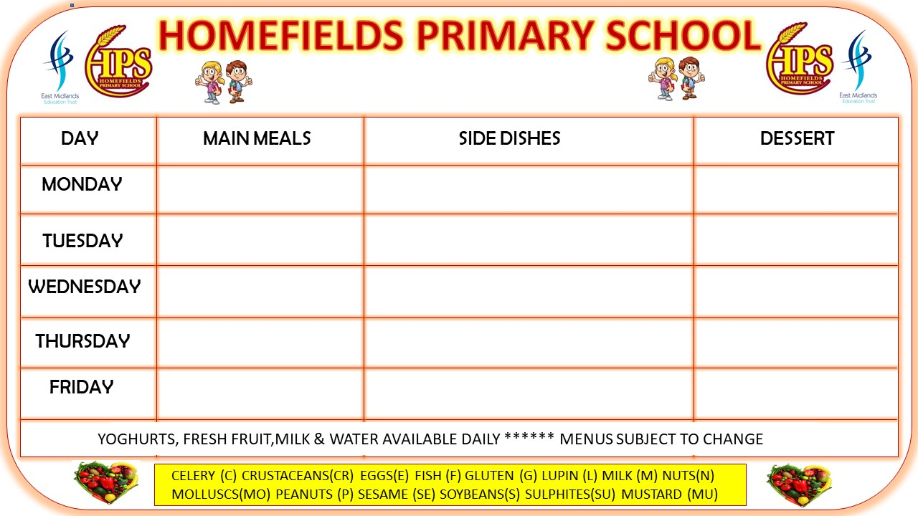
AFTERSCHOOL CLUB
Afterschool Menu
Week 1
MEAL | DESERT
Pasta and Cheese (G,M) | Jelly Pots
Sandwiches and Crisps (G,M) | Biscuits (G)
Chips and Baked Beans | Yogurt (M)
Chicken Nugget Wraps (G) | Cake (G,M,E)
Cobs and Crisps (M,G) | Biscuits (G)
VEGETARIAN OPTIONS ARE ALWAYS AVAILABLE - MENUS SUBJECT TO CHANGE

Slide 2
AFTERSCHOOL CLUB
Afterschool Menu
Week 2
MEAL | DESERT
Baked Beans, Toast (G) | Biscuits (G)
Sandwiches (G,M), Crisps & Salad | Cake (G,M,E)
Jacket Potato, Cheese or Sweetcorn (M) | Jelly Pots
Chips with Spaghetti Loops (G) | Yogurt (M)
Sausages and Finger Rolls (G) | Biscuit (G)
VEGETARIAN OPTIONS ARE ALWAYS AVAILABLE - MENUS SUBJECT TO CHANGE

Slide 3
AFTERSCHOOL CLUB
Afterschool Menu
Week 3
MEAL | DESERT
Jacket Potato, Cheese and Baked Beans (M) | Cake (G,M,E)
Sandwiches and Crisps (G,M) | Yogurt (M)
Chips and Spaghetti Loops (G) | Biscuits (G)
Pasta and Cheese (G,M) | Jelly Pots
Wraps and Crisps (M) | Biscuits (G)
VEGETARIAN OPTIONS ARE ALWAYS AVAILABLE - MENUS SUBJECT TO CHANGE

Slide 4
AFTERSCHOOL CLUB
Afterschool Menu
Week 4
MEAL | DESERT
Fish Finger Wraps (F) | Yogurt (M)
Sandwiches and Crisps (G,M) | Cake (G,M,E)
Pasta and Cheese (G,M) | Biscuits (G)
Chips and Spaghetti Loops (G) | Jelly Pots
Cobs and Crisps (G,M) | Cake (G,M,E)
VEGETARIAN OPTIONS ARE ALWAYS AVAILABLE - MENUS SUBJECT TO CHANGE

