Slide 1
Welcome to Homefields Nursery

Slide 2
Nursery Staff.
Mrs Harris is the nursery teacher.

Slide 3
Nursery staff.
Mrs Lewis is the teaching assistant in nursery.

Slide 4
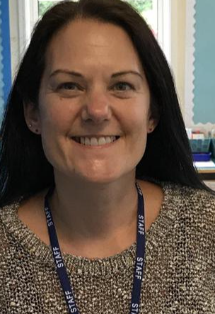
Nursery staff
Mrs Holmes is the teaching assistant who supervises lunch times in nursery.

Slide 5
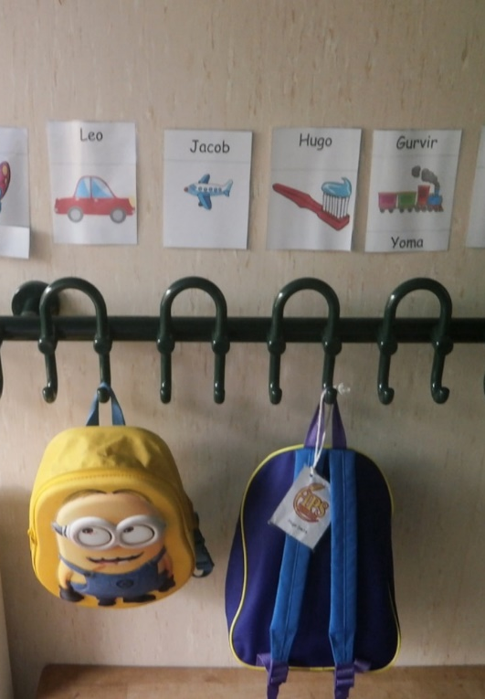
Coat peg.
In the cloakroom, you will have a peg to hang up your coat and bag.

Slide 6
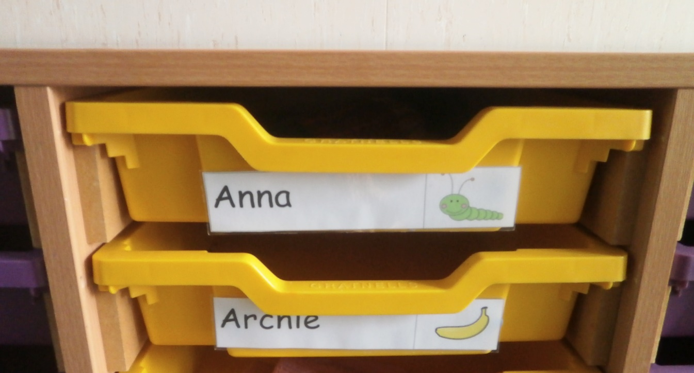
Drawers.
In the cloakroom, you will have your own drawer. Staff will put work and letters in here, so please check regularly.

Slide 7
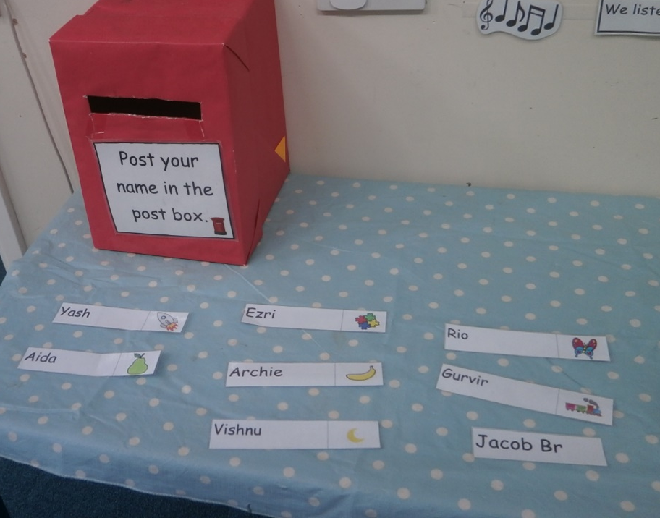
Post box.
When you come in to nursery, you will post your name in to the red post box.

Slide 8
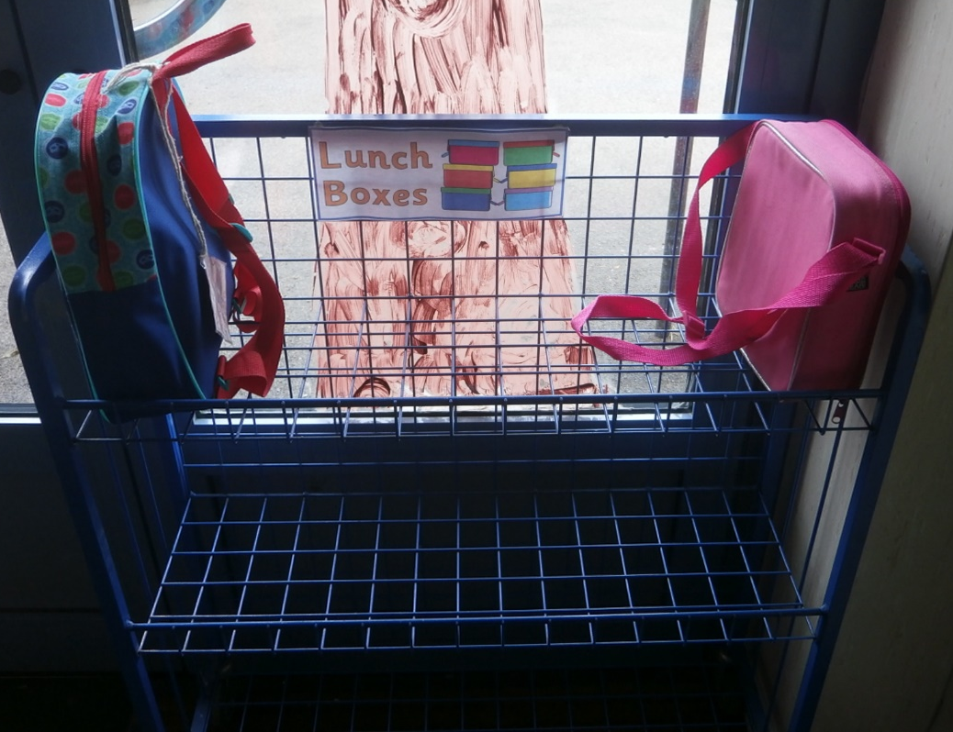
Lunch trolley.
Your lunch box will go on this trolley.

Slide 9
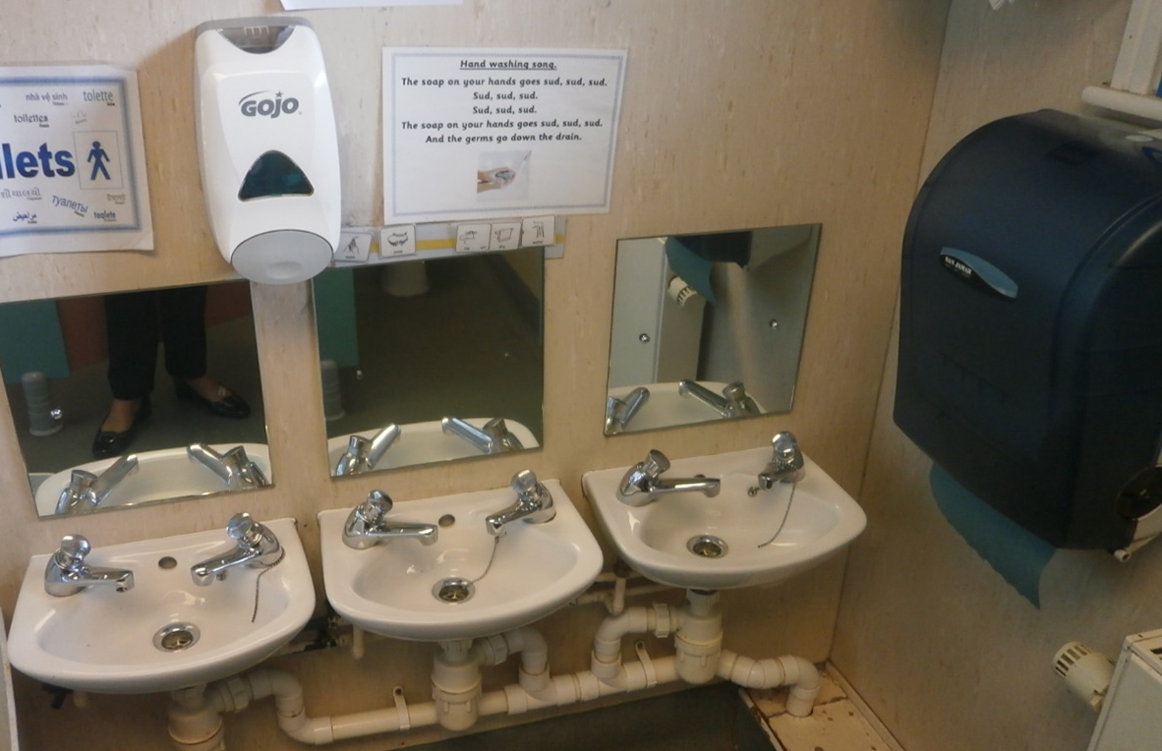
Nursery toilets.

Slide 10
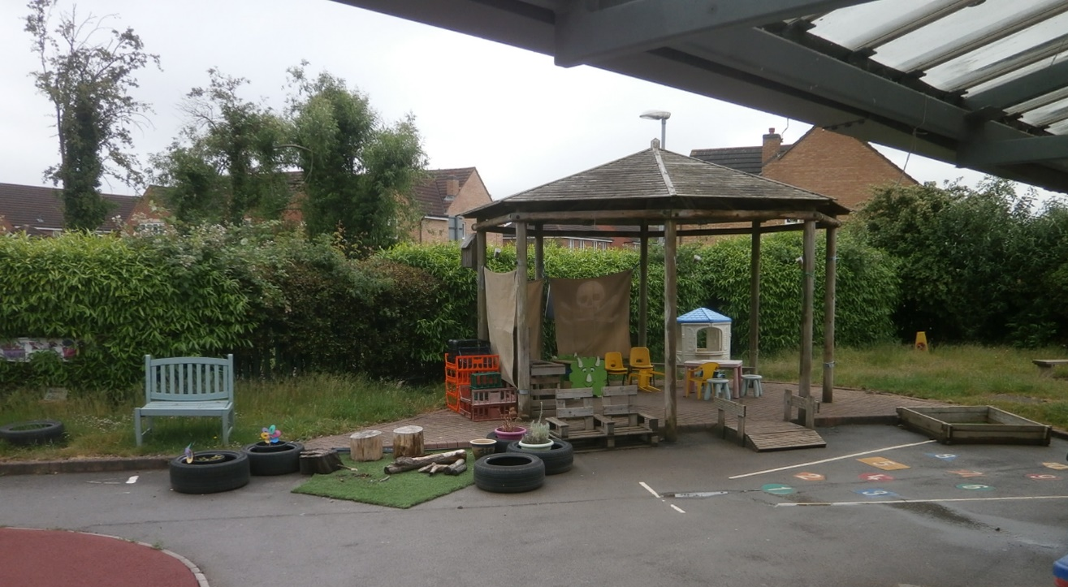
Nursery garden.

Slide 11
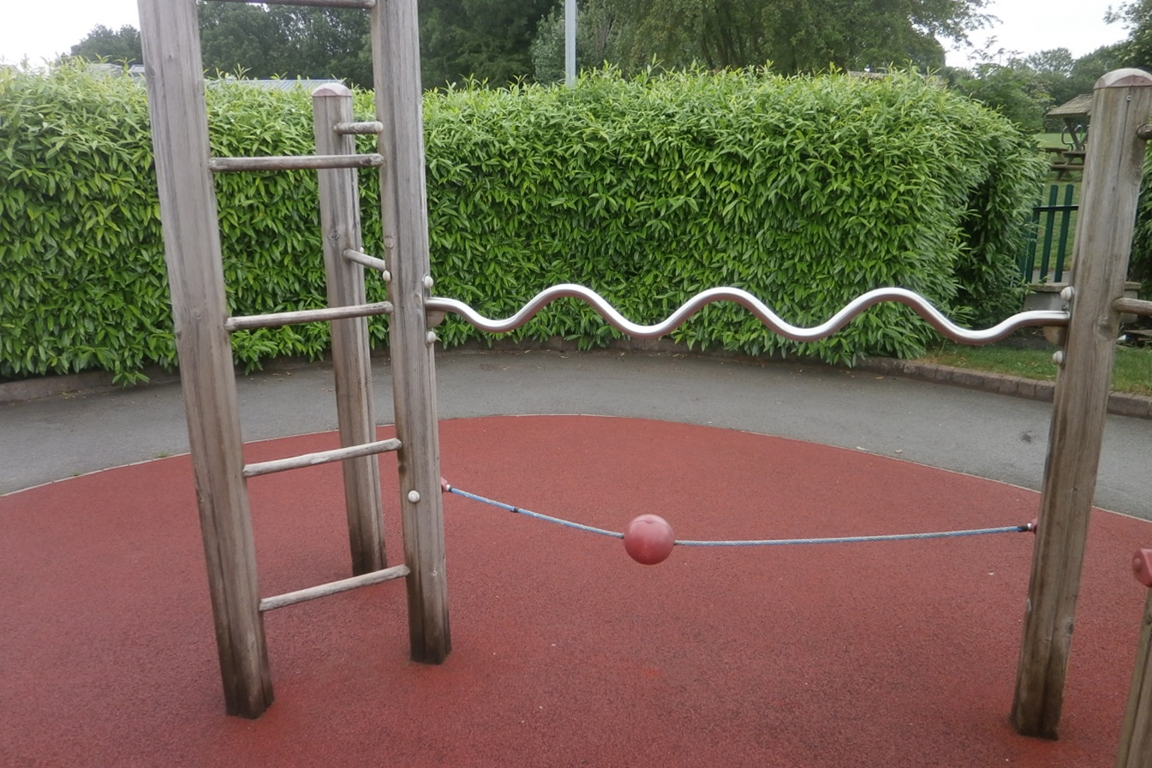
We can climb at nursery.

Slide 12
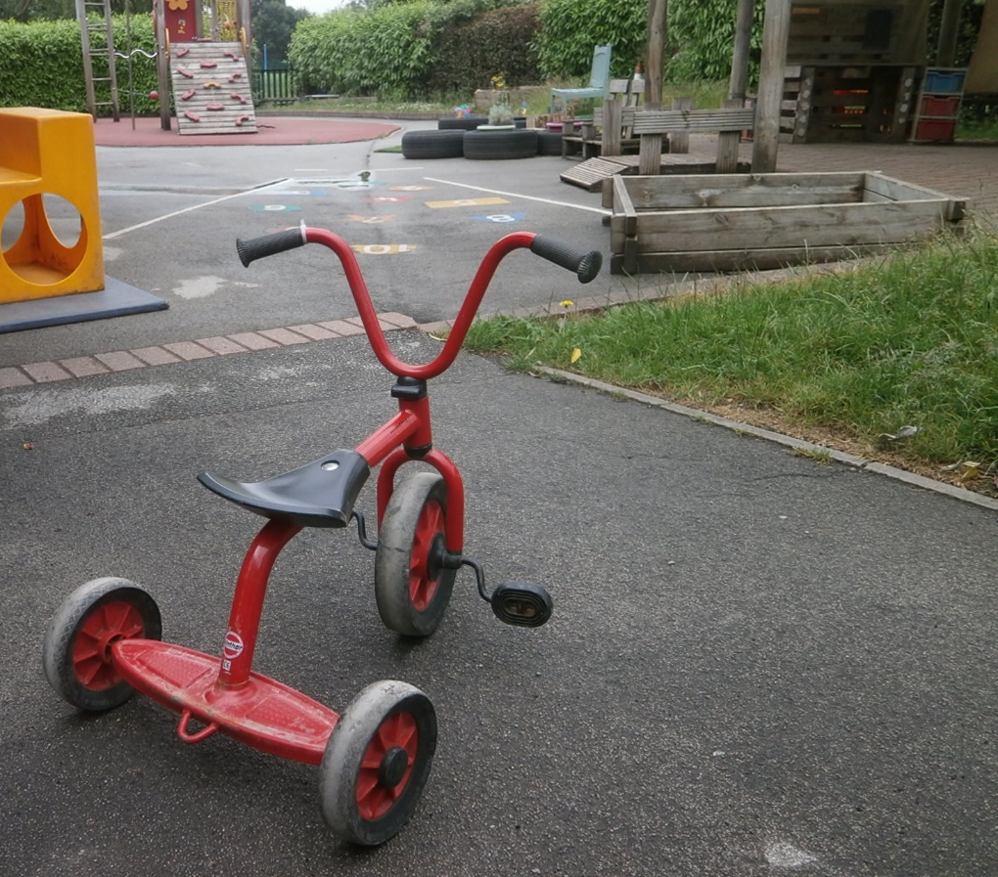
We can ride bikes at nursery.

Slide 13
We can share books at nursery.

Slide 14
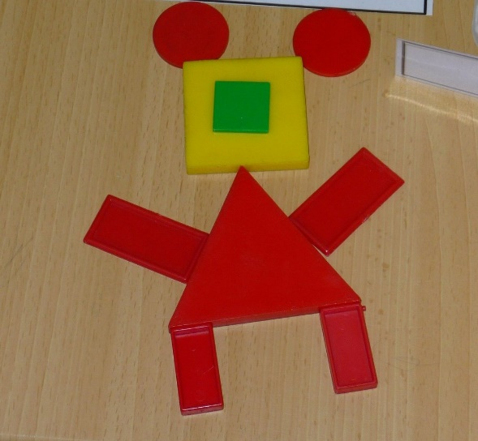
We can learn about numbers and shapes at nursery.

Slide 15
We can paint at nursery.

Slide 16
We can draw and write at nursery.

Slide 17
We can make things at nursery.

Slide 18
We can build at nursery.

Slide 19
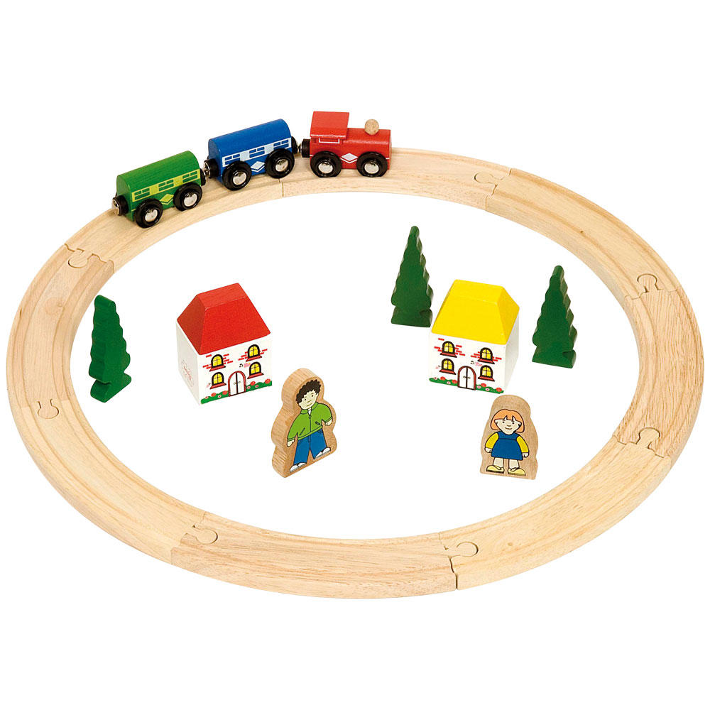
We can play with small world toys at nursery.

Slide 20
We can play with water at nursery.

Slide 21
We can play with sand at nursery.

Slide 22
We can learn Makaton at nursery.

Slide 23
We can make friends at nursery.

Slide 24
We can’t wait to meet you and help you step into the start of your learning journey!

